Slide 1
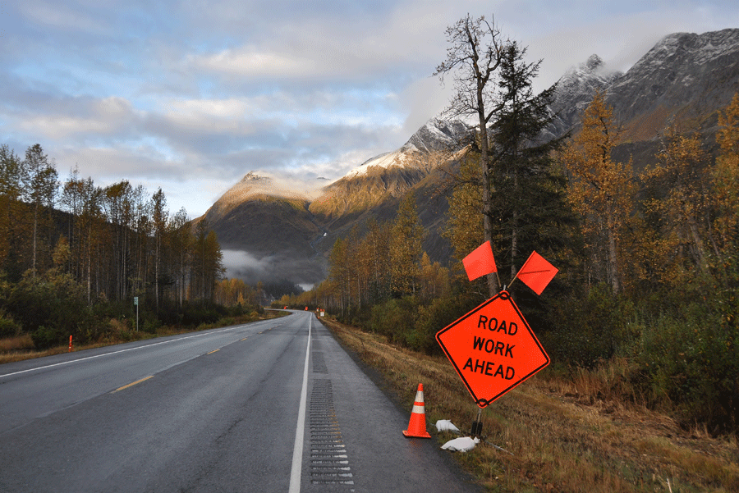


Slide 2
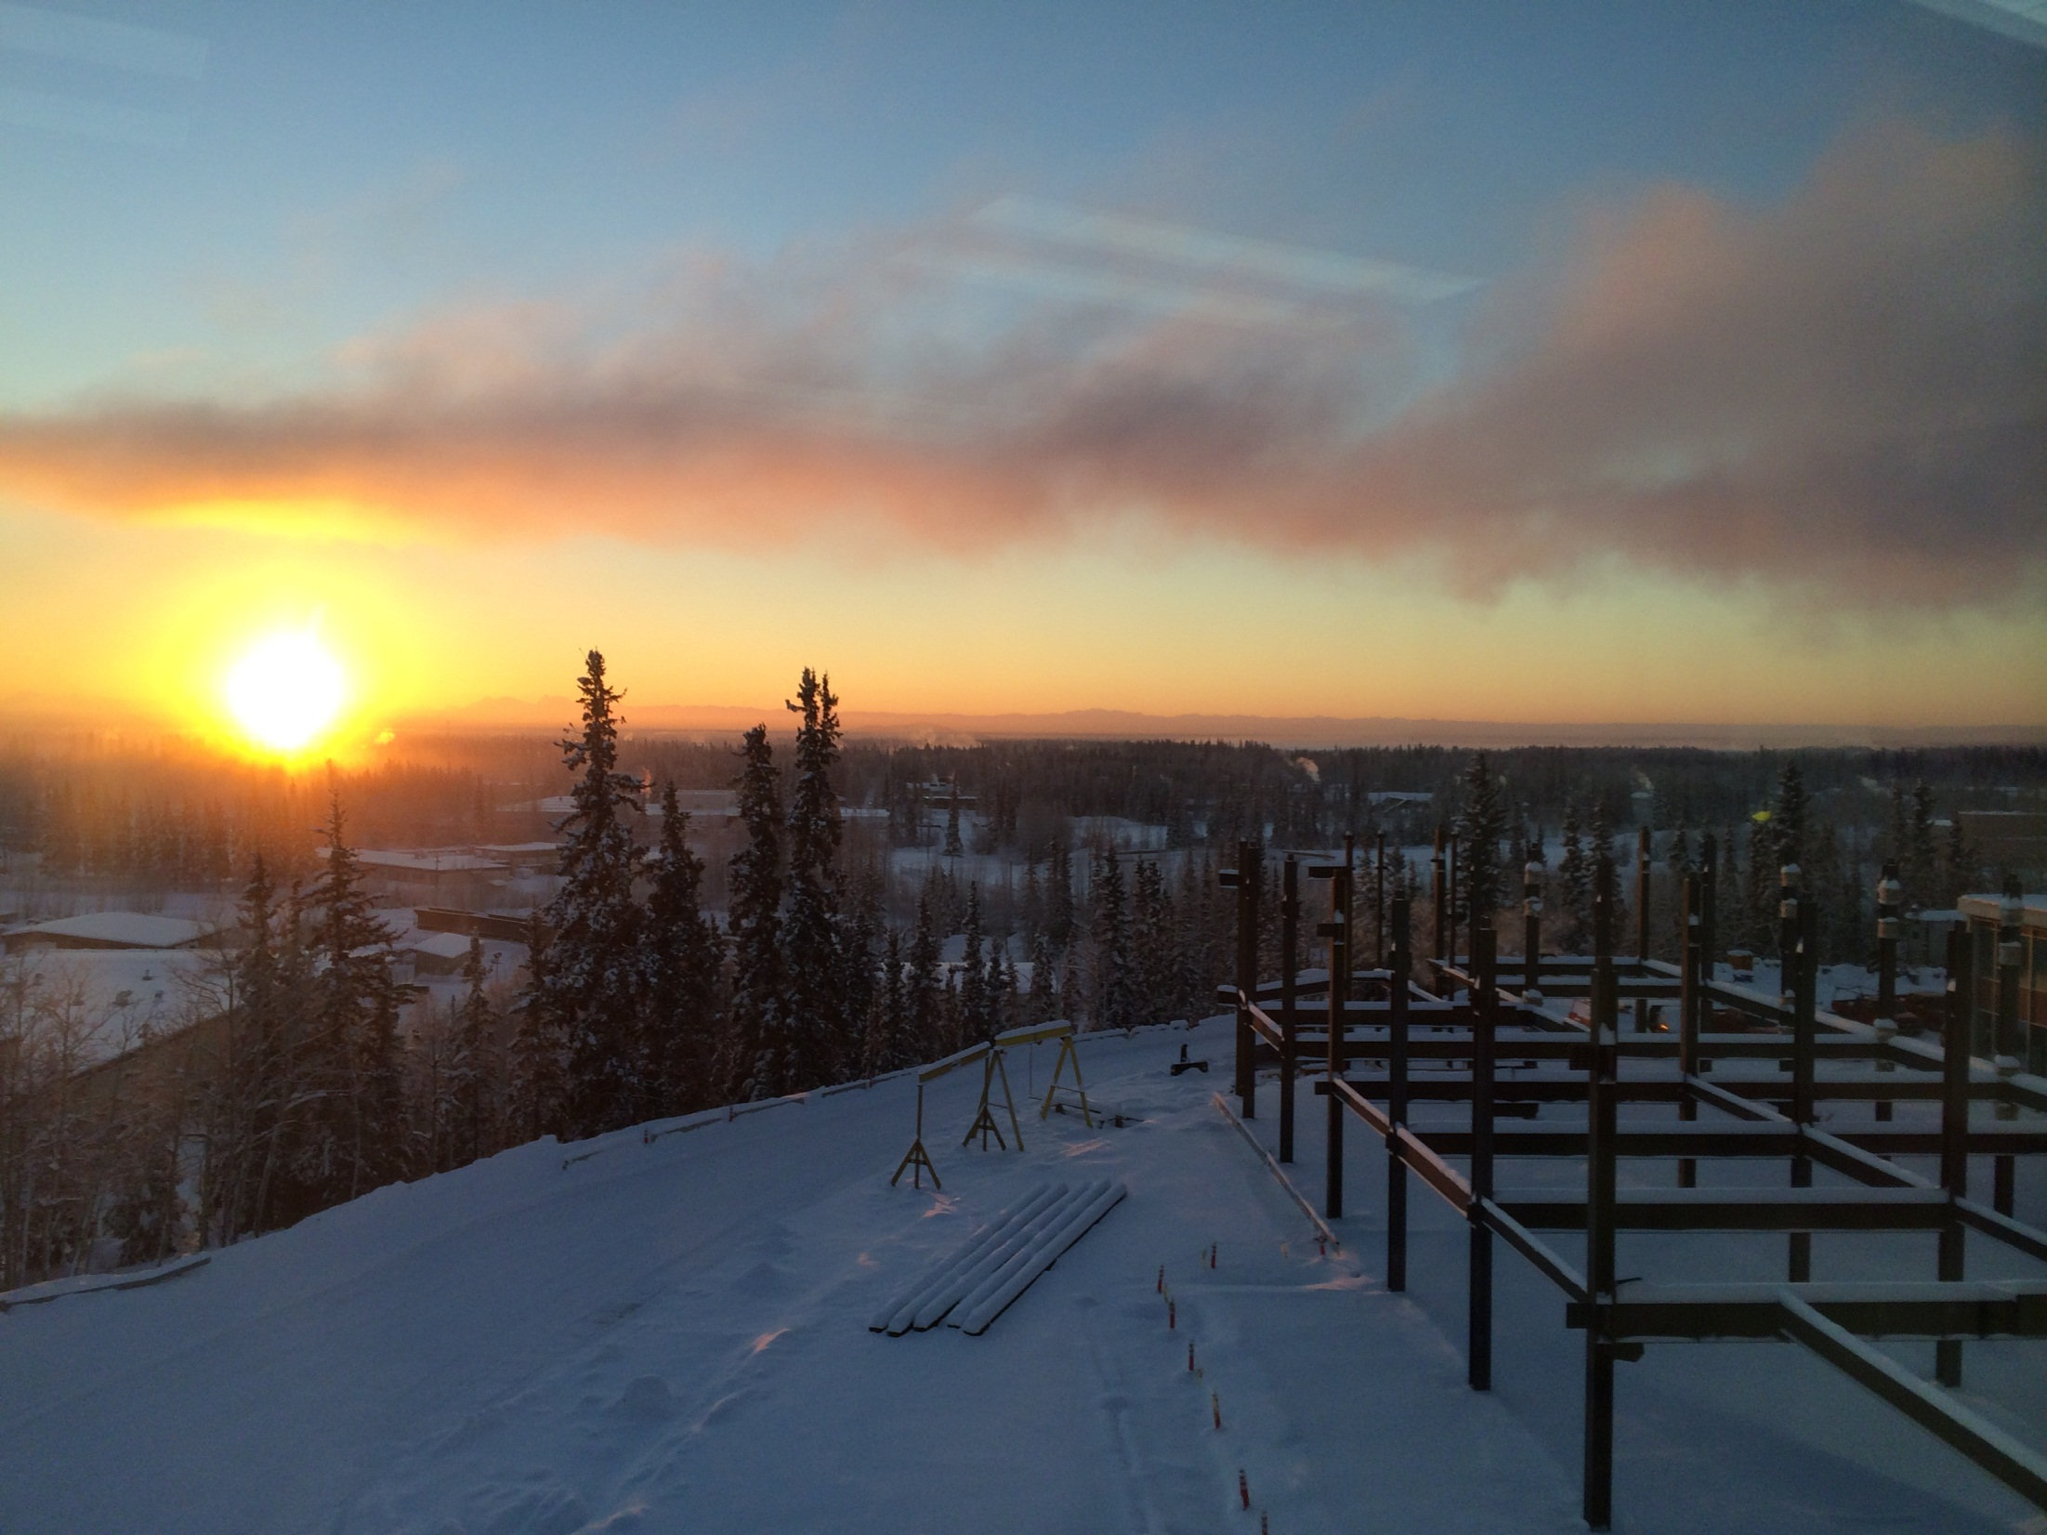
Sunset over the new UAF engineering building
Photo courtesy Ann Ringstad

Slide 3
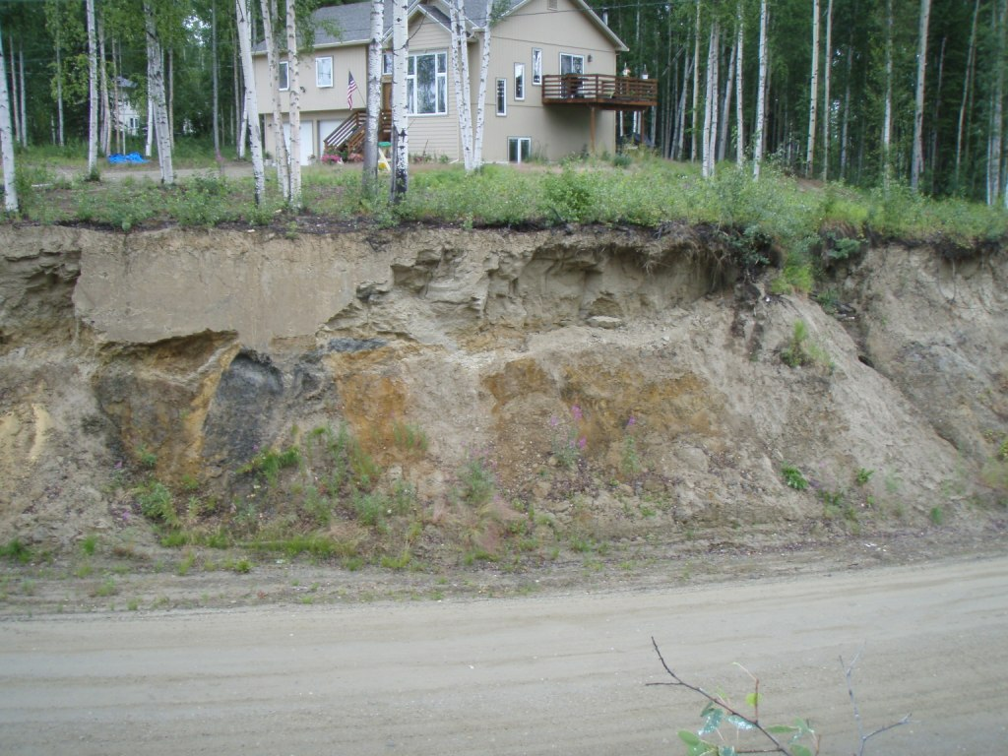

Slide 4
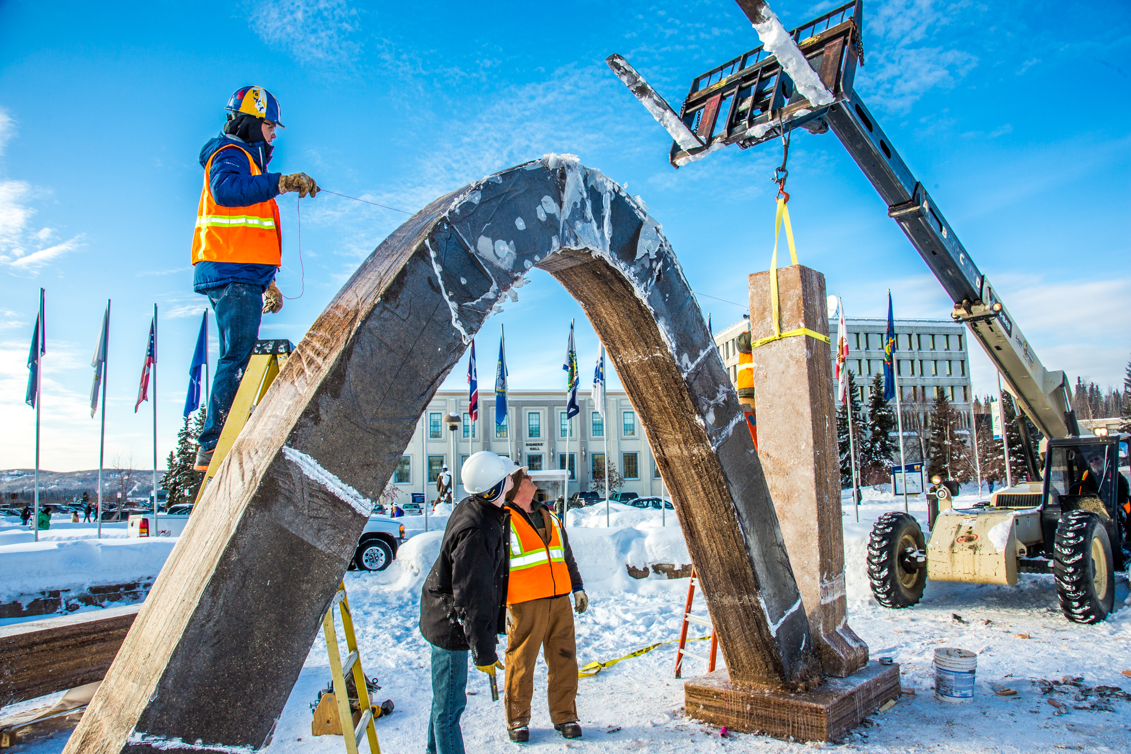
Engineering students and volunteers from GHEMM Company raise the 2013 ice arch
UAF Photo by Todd Paris

Slide 5
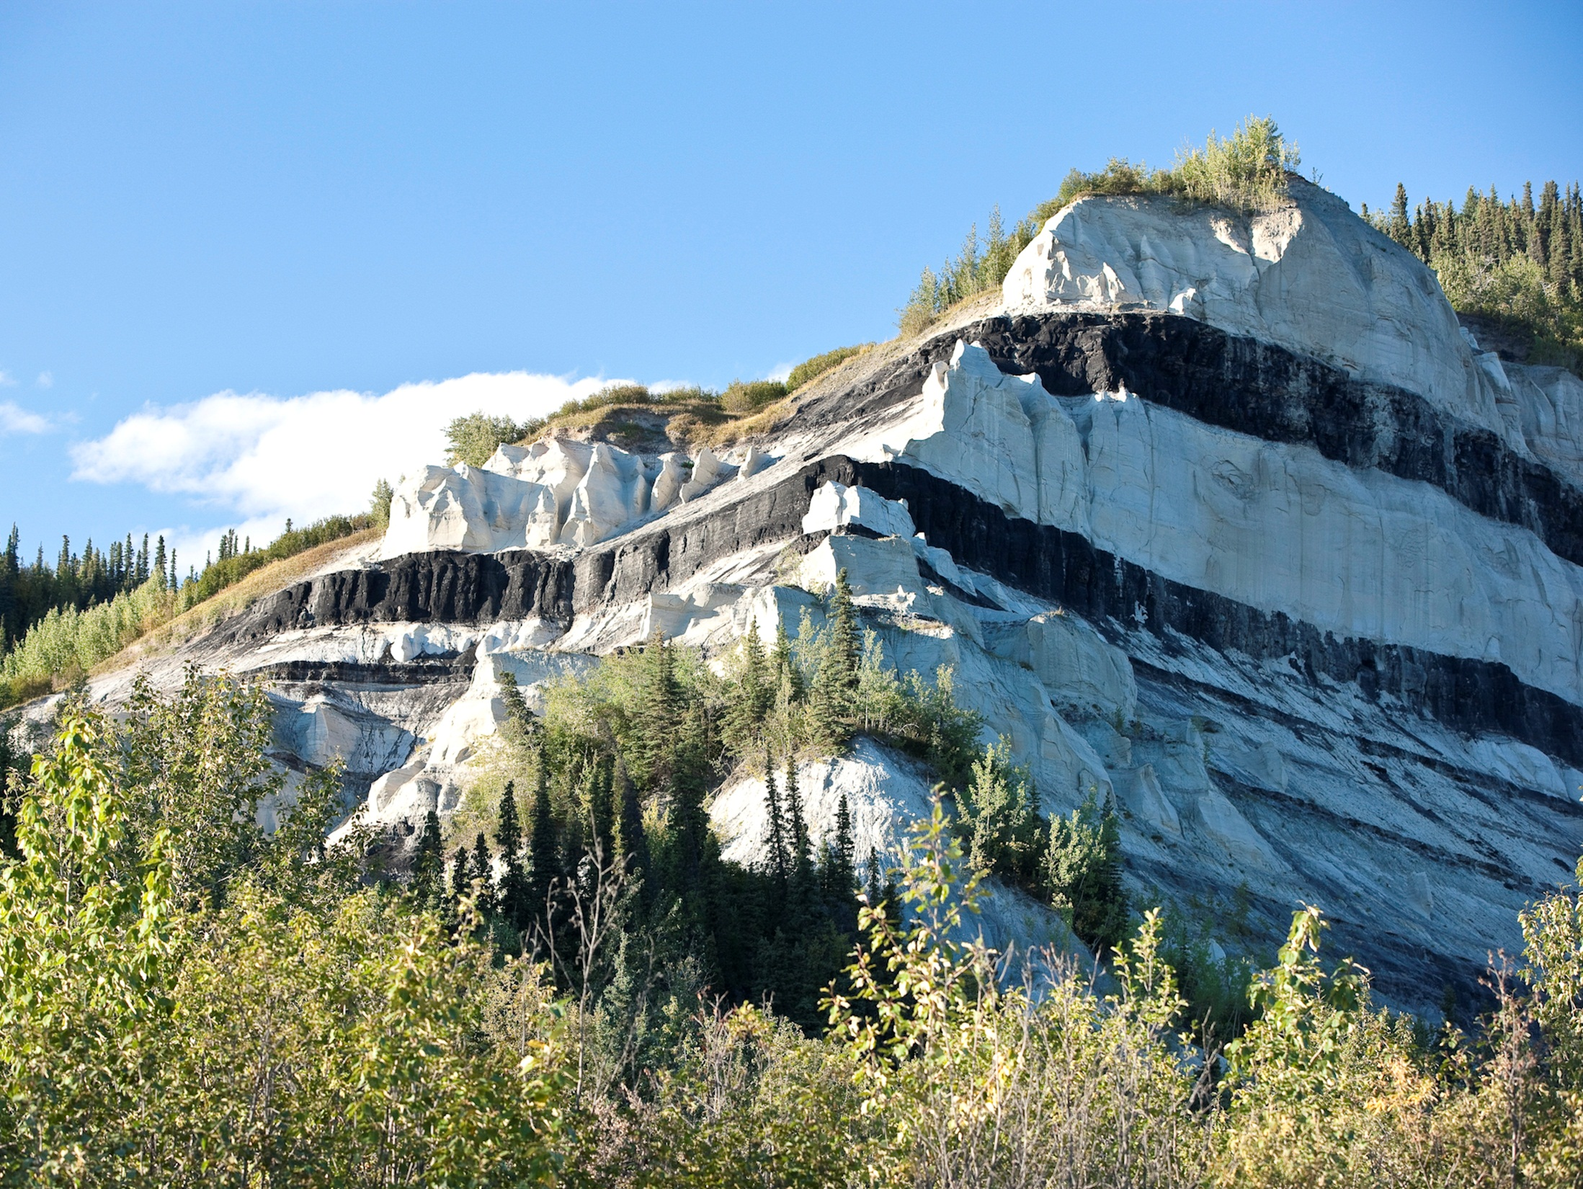


Slide 6

Math Counts Challenge!
A restaurant automatically adds an 18% tip to the bill. If the tip was $9, what was the bill before the tip was added, in dollars?
Answer to follow

Slide 7
Answer: 50 (dollars)

Slide 8
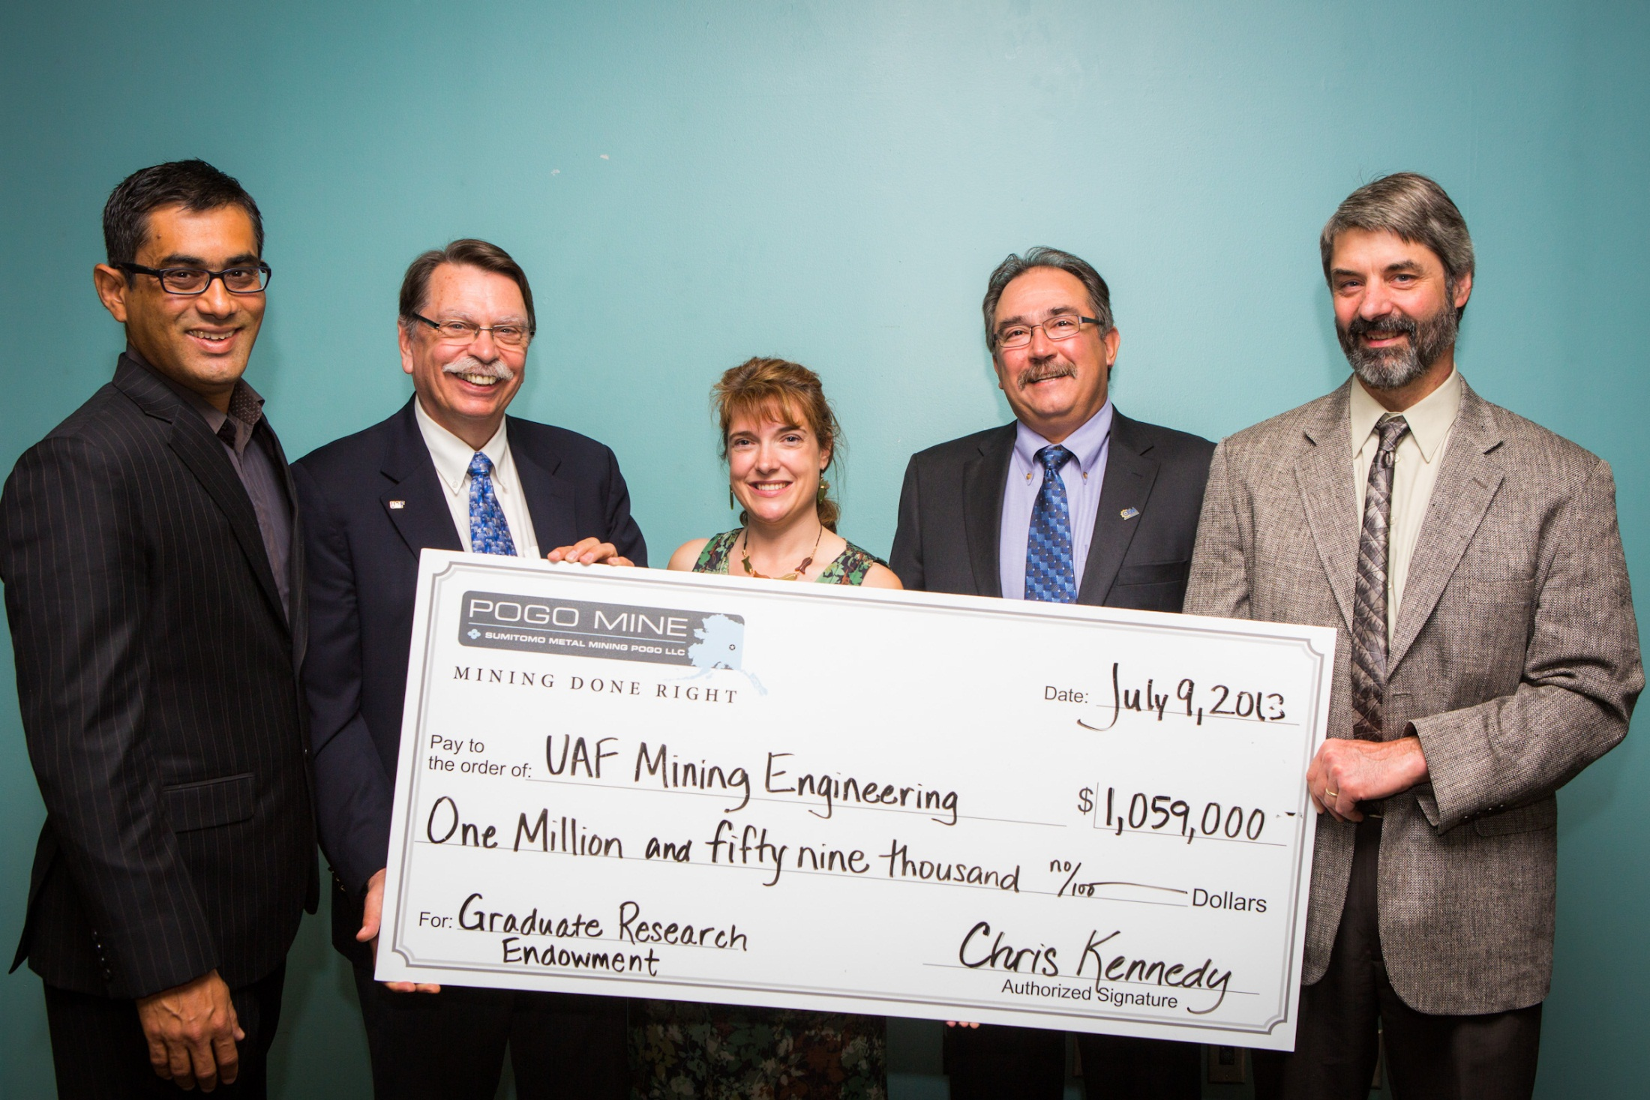
POGO Mine Supports UAF CEM Graduate Research
Photo Courtesy of CEM

Slide 9
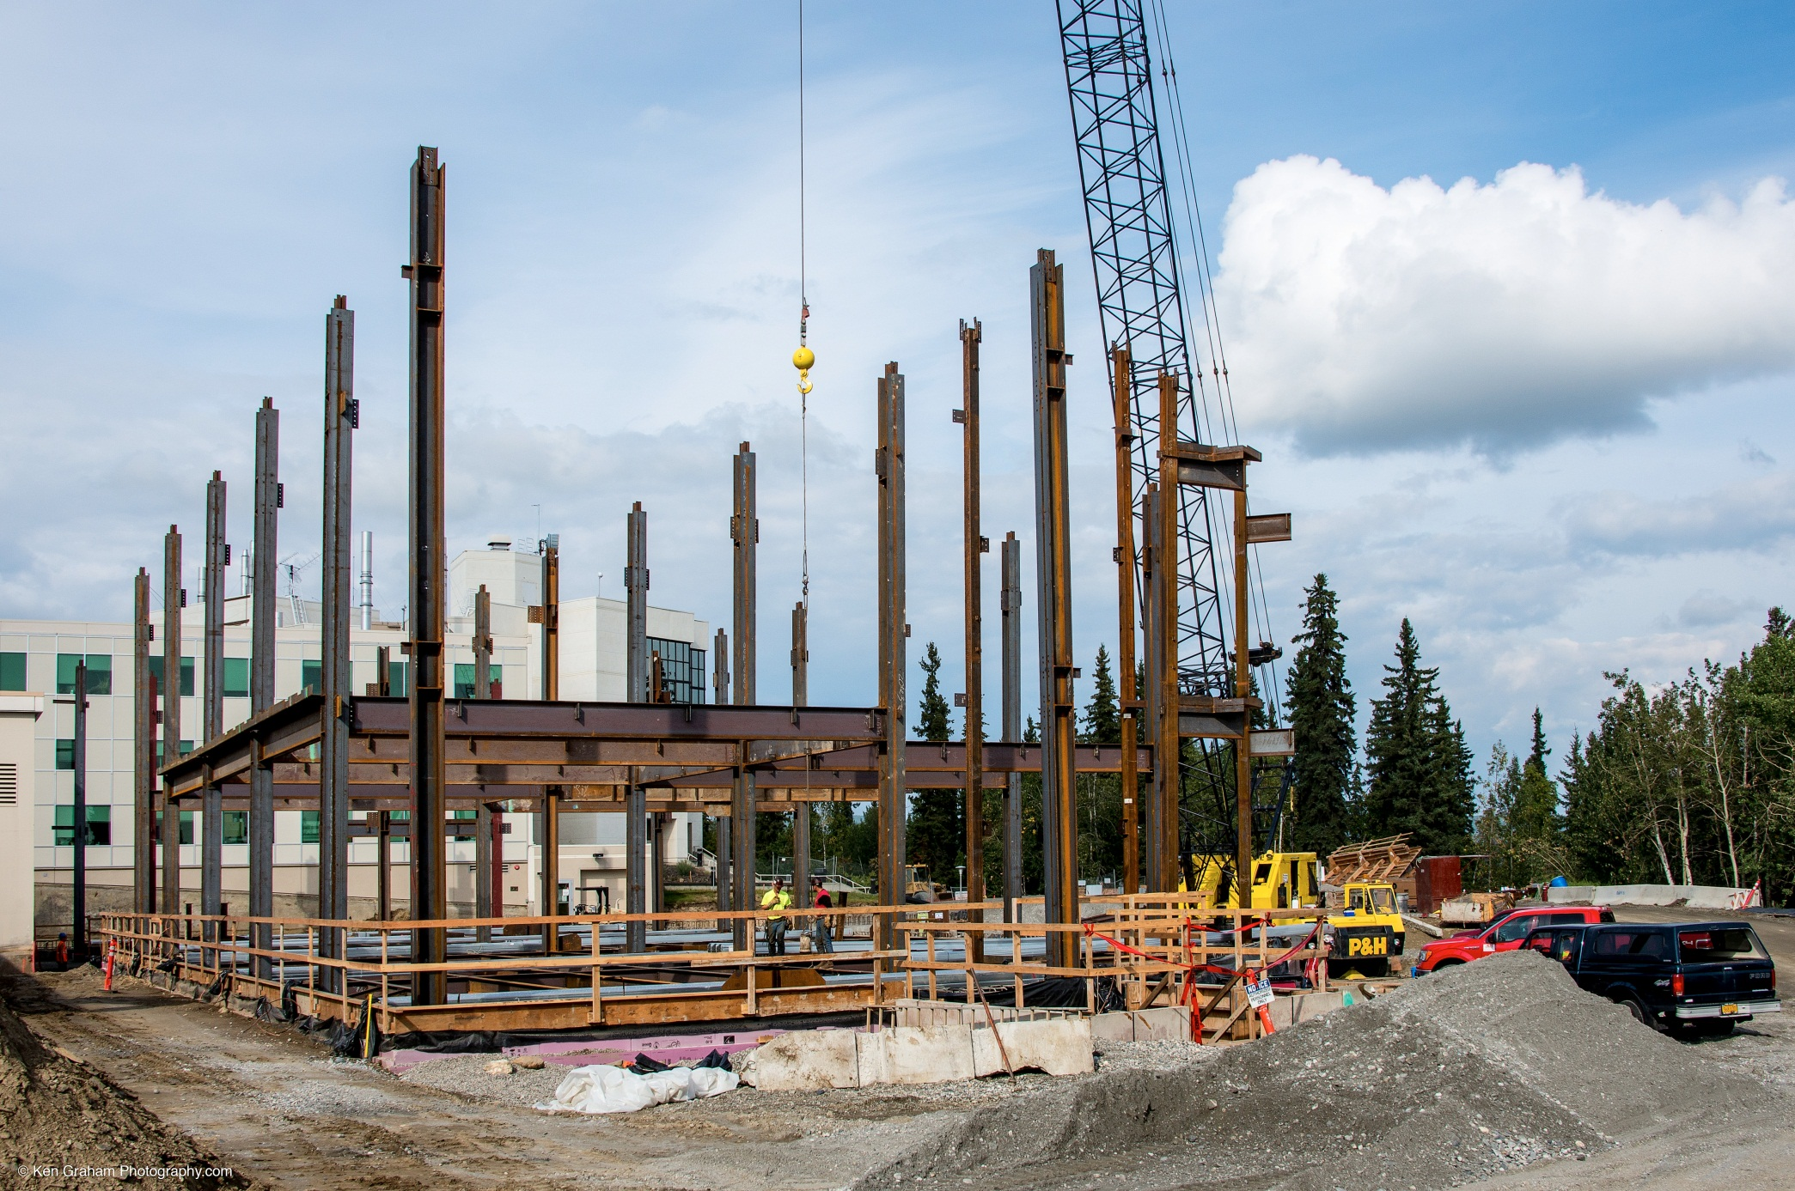


Slide 10
ConocoPhillips has been leading the search for energy in Alaska for more than 50 years. The company is committed to responsibly developing Alaska’s resources, providing economic opportunity for Alaska, operating at the highest safety standards and being good stewards of our communities.

Slide 11
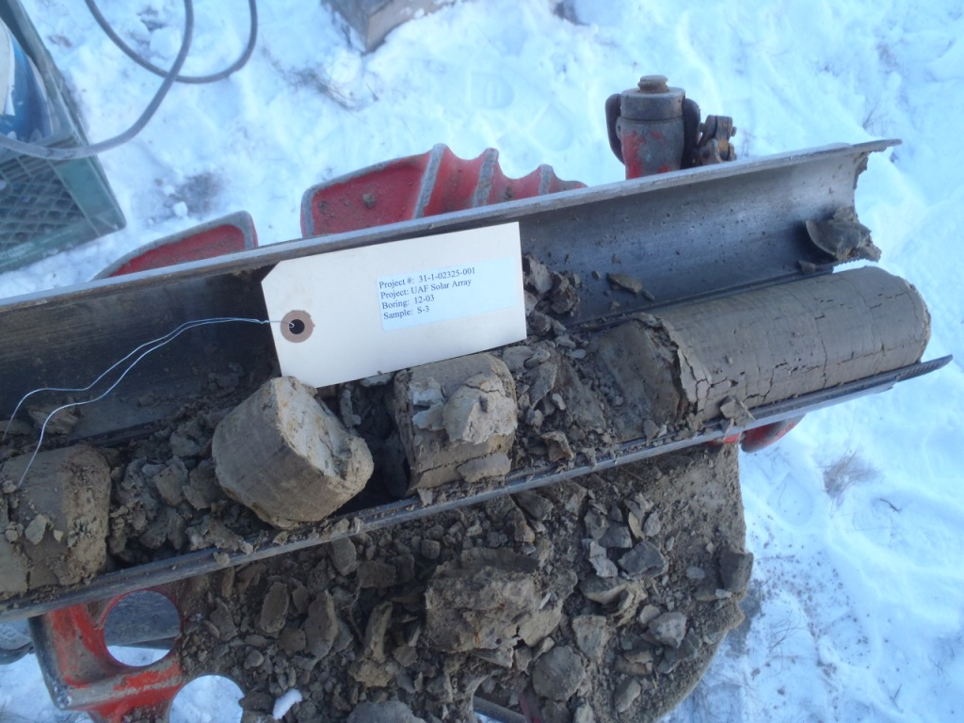

Slide 12
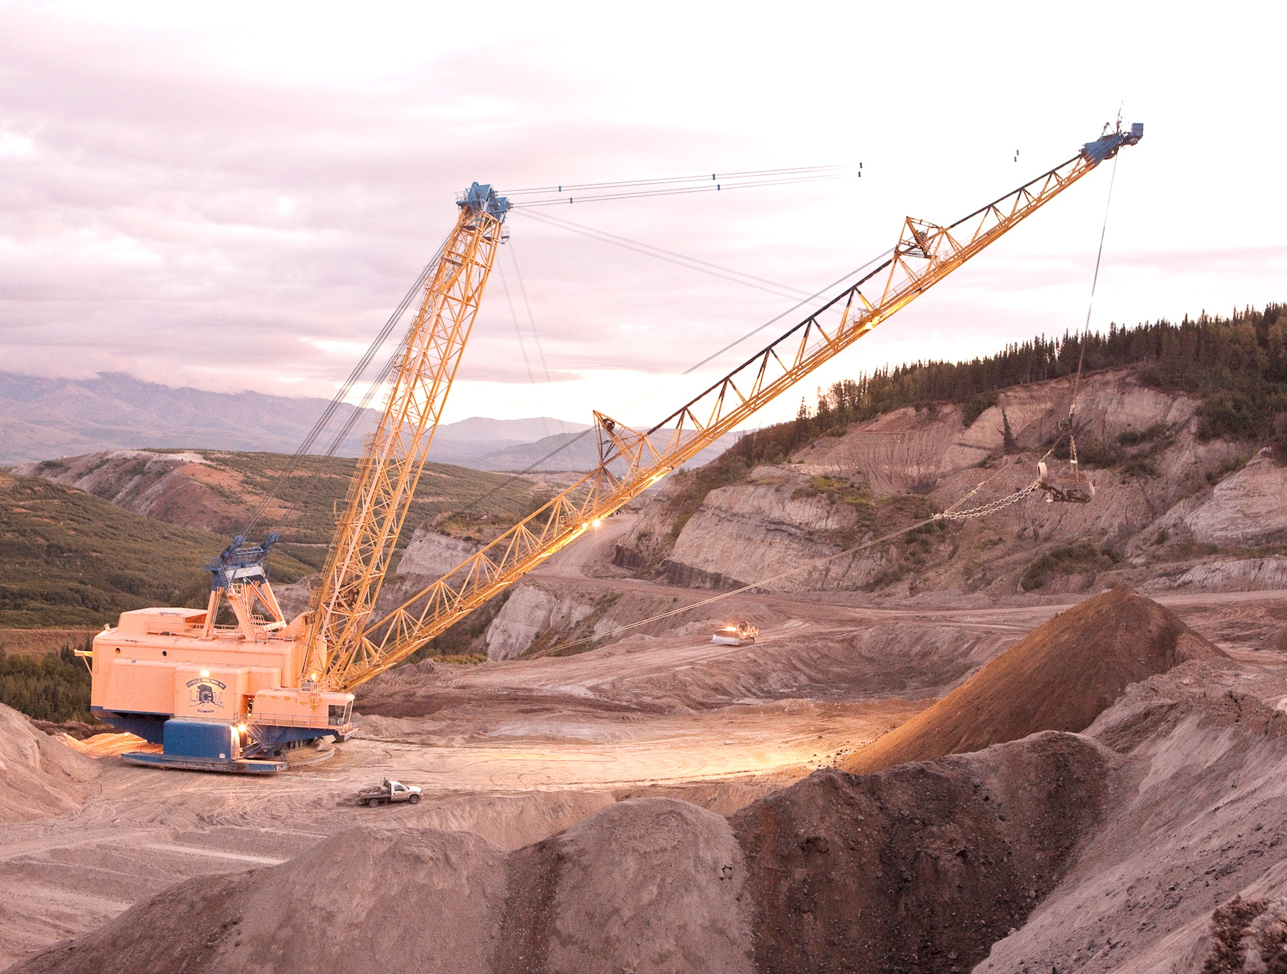

Slide 13
Math Counts Challenge!
What is the smallest positive integer a such that is an integer?
1
2
3
a²
Answer to follow

Slide 14
Answer: 6

Slide 15
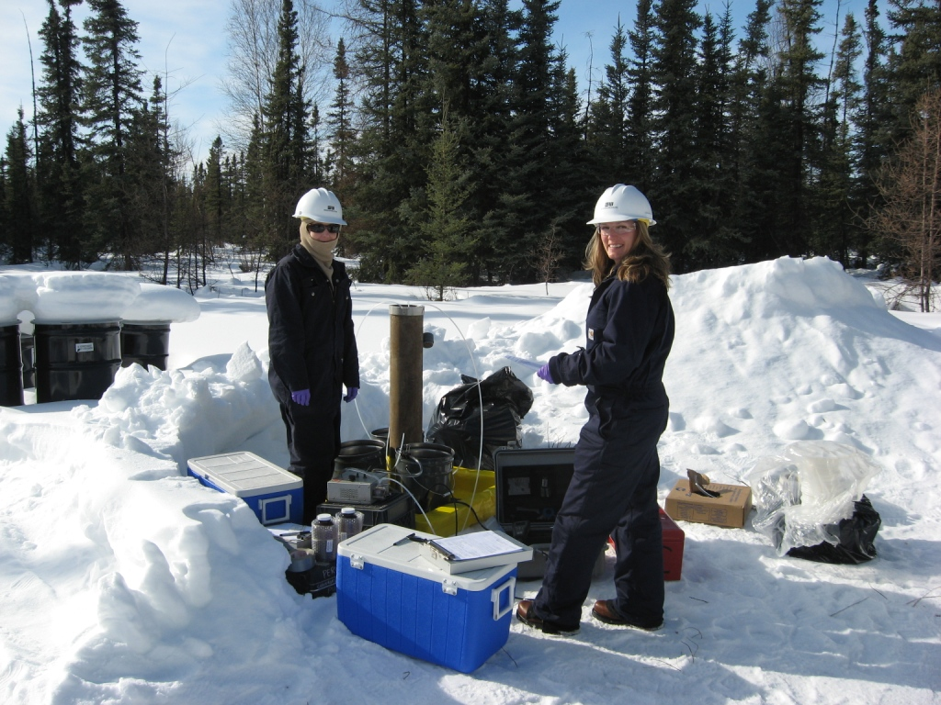

Slide 16
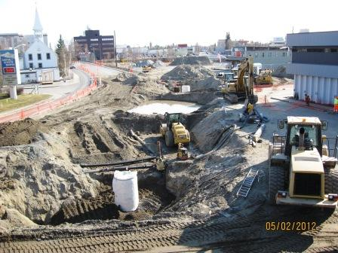
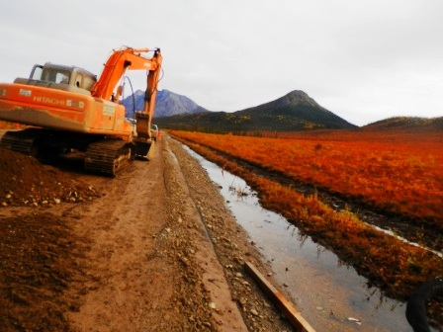

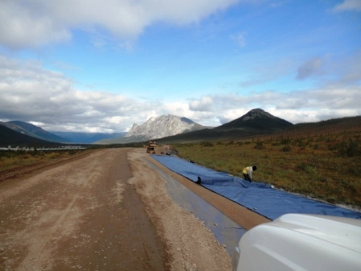
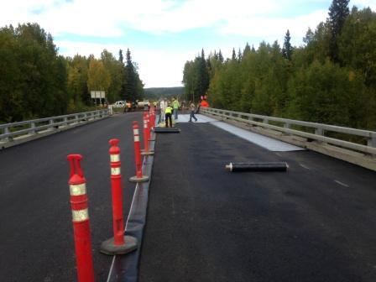
Contractors
• Paving
• Site Development
• Geotextile

Slide 17
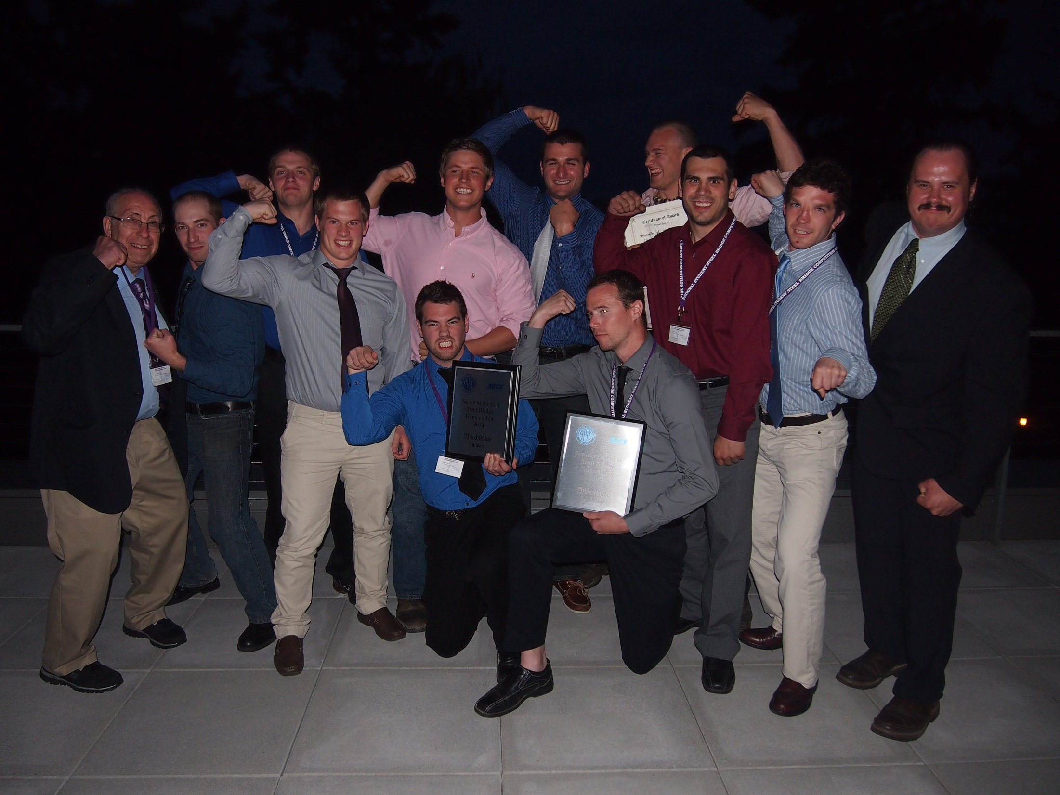
CEM students and faculty at the 2013 National Student Steel Bridge Competition

Slide 18

THANK YOU TO OUR
GENEROUS SPONSORS

Slide 19
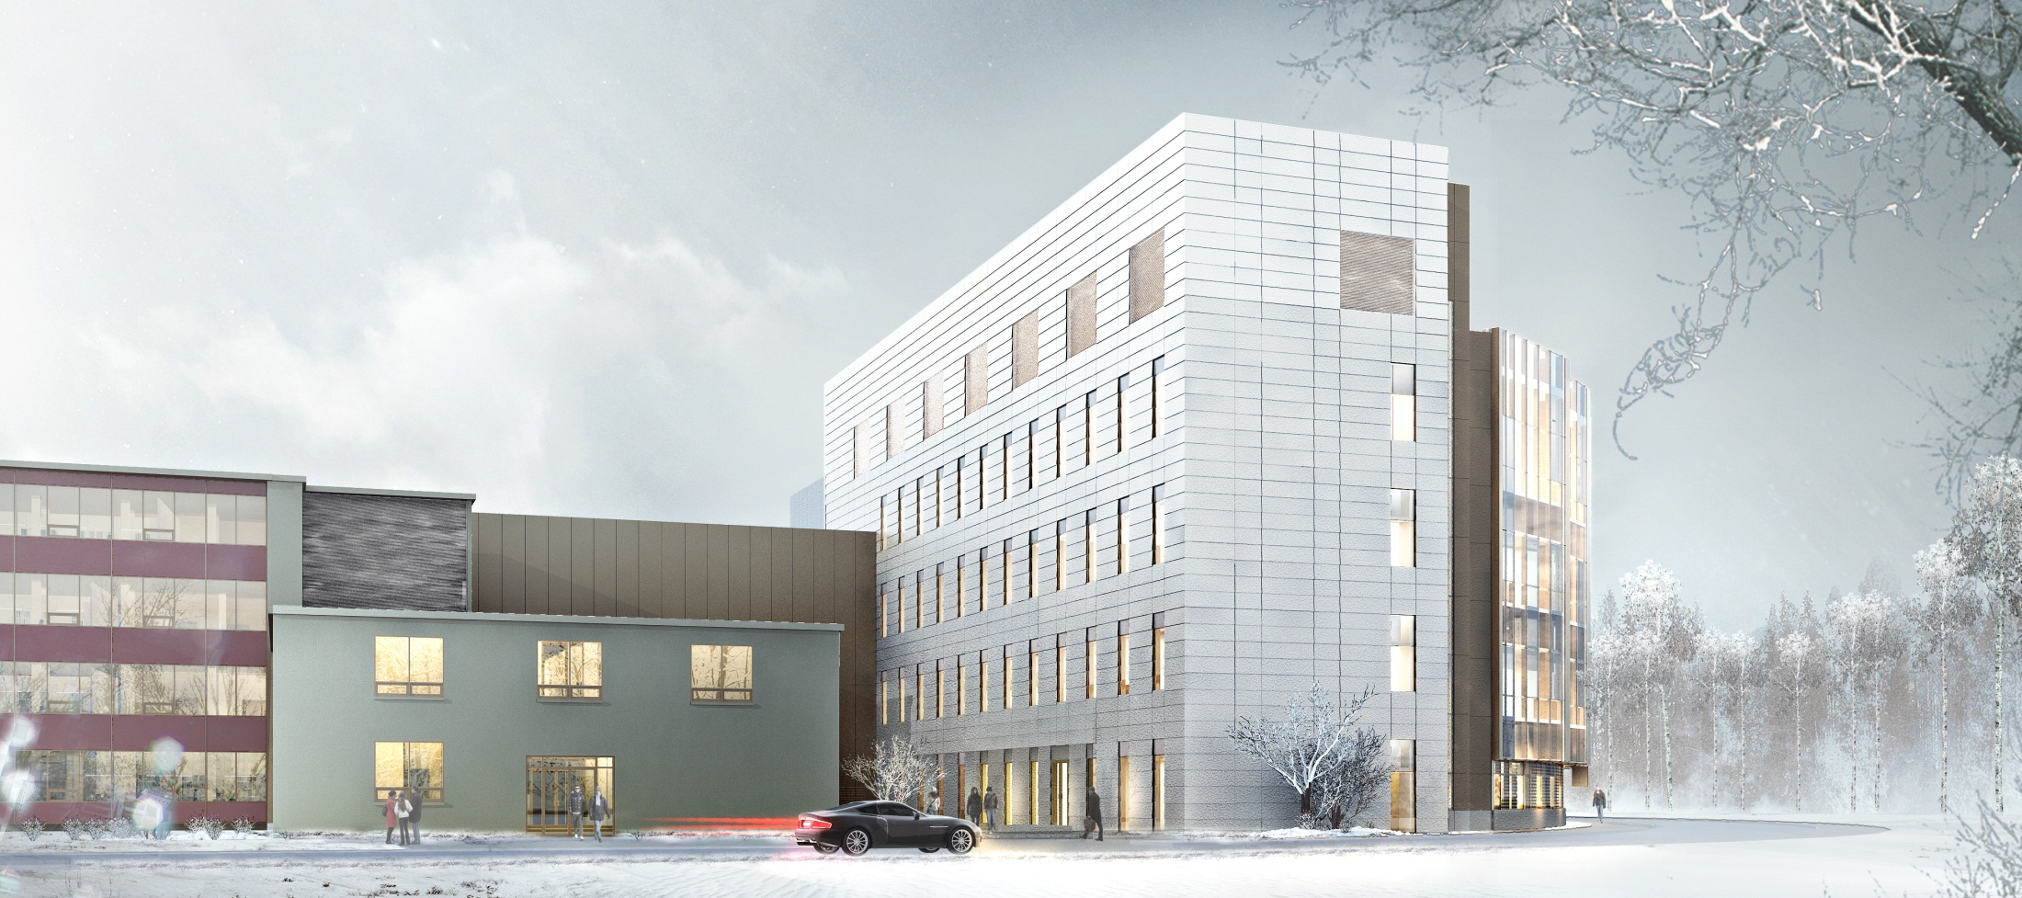

Duckering Building Extension - University of Alaska Fairbanks

Slide 20
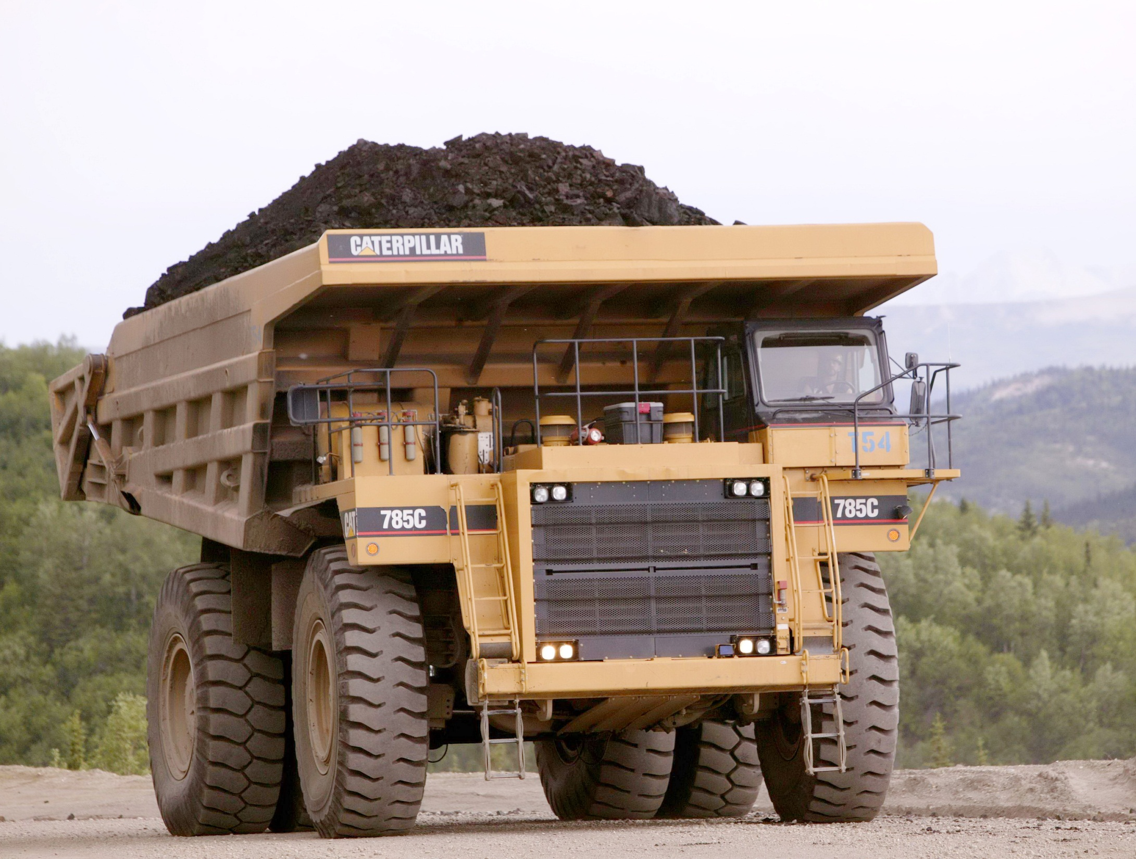

Slide 21
Math Counts Challenge!
The cost of daily school lunch increased from $1.80 to $2.25. What was the percent increase?
Answer to follow

Slide 22
Answer: 25 (percent)

Slide 23
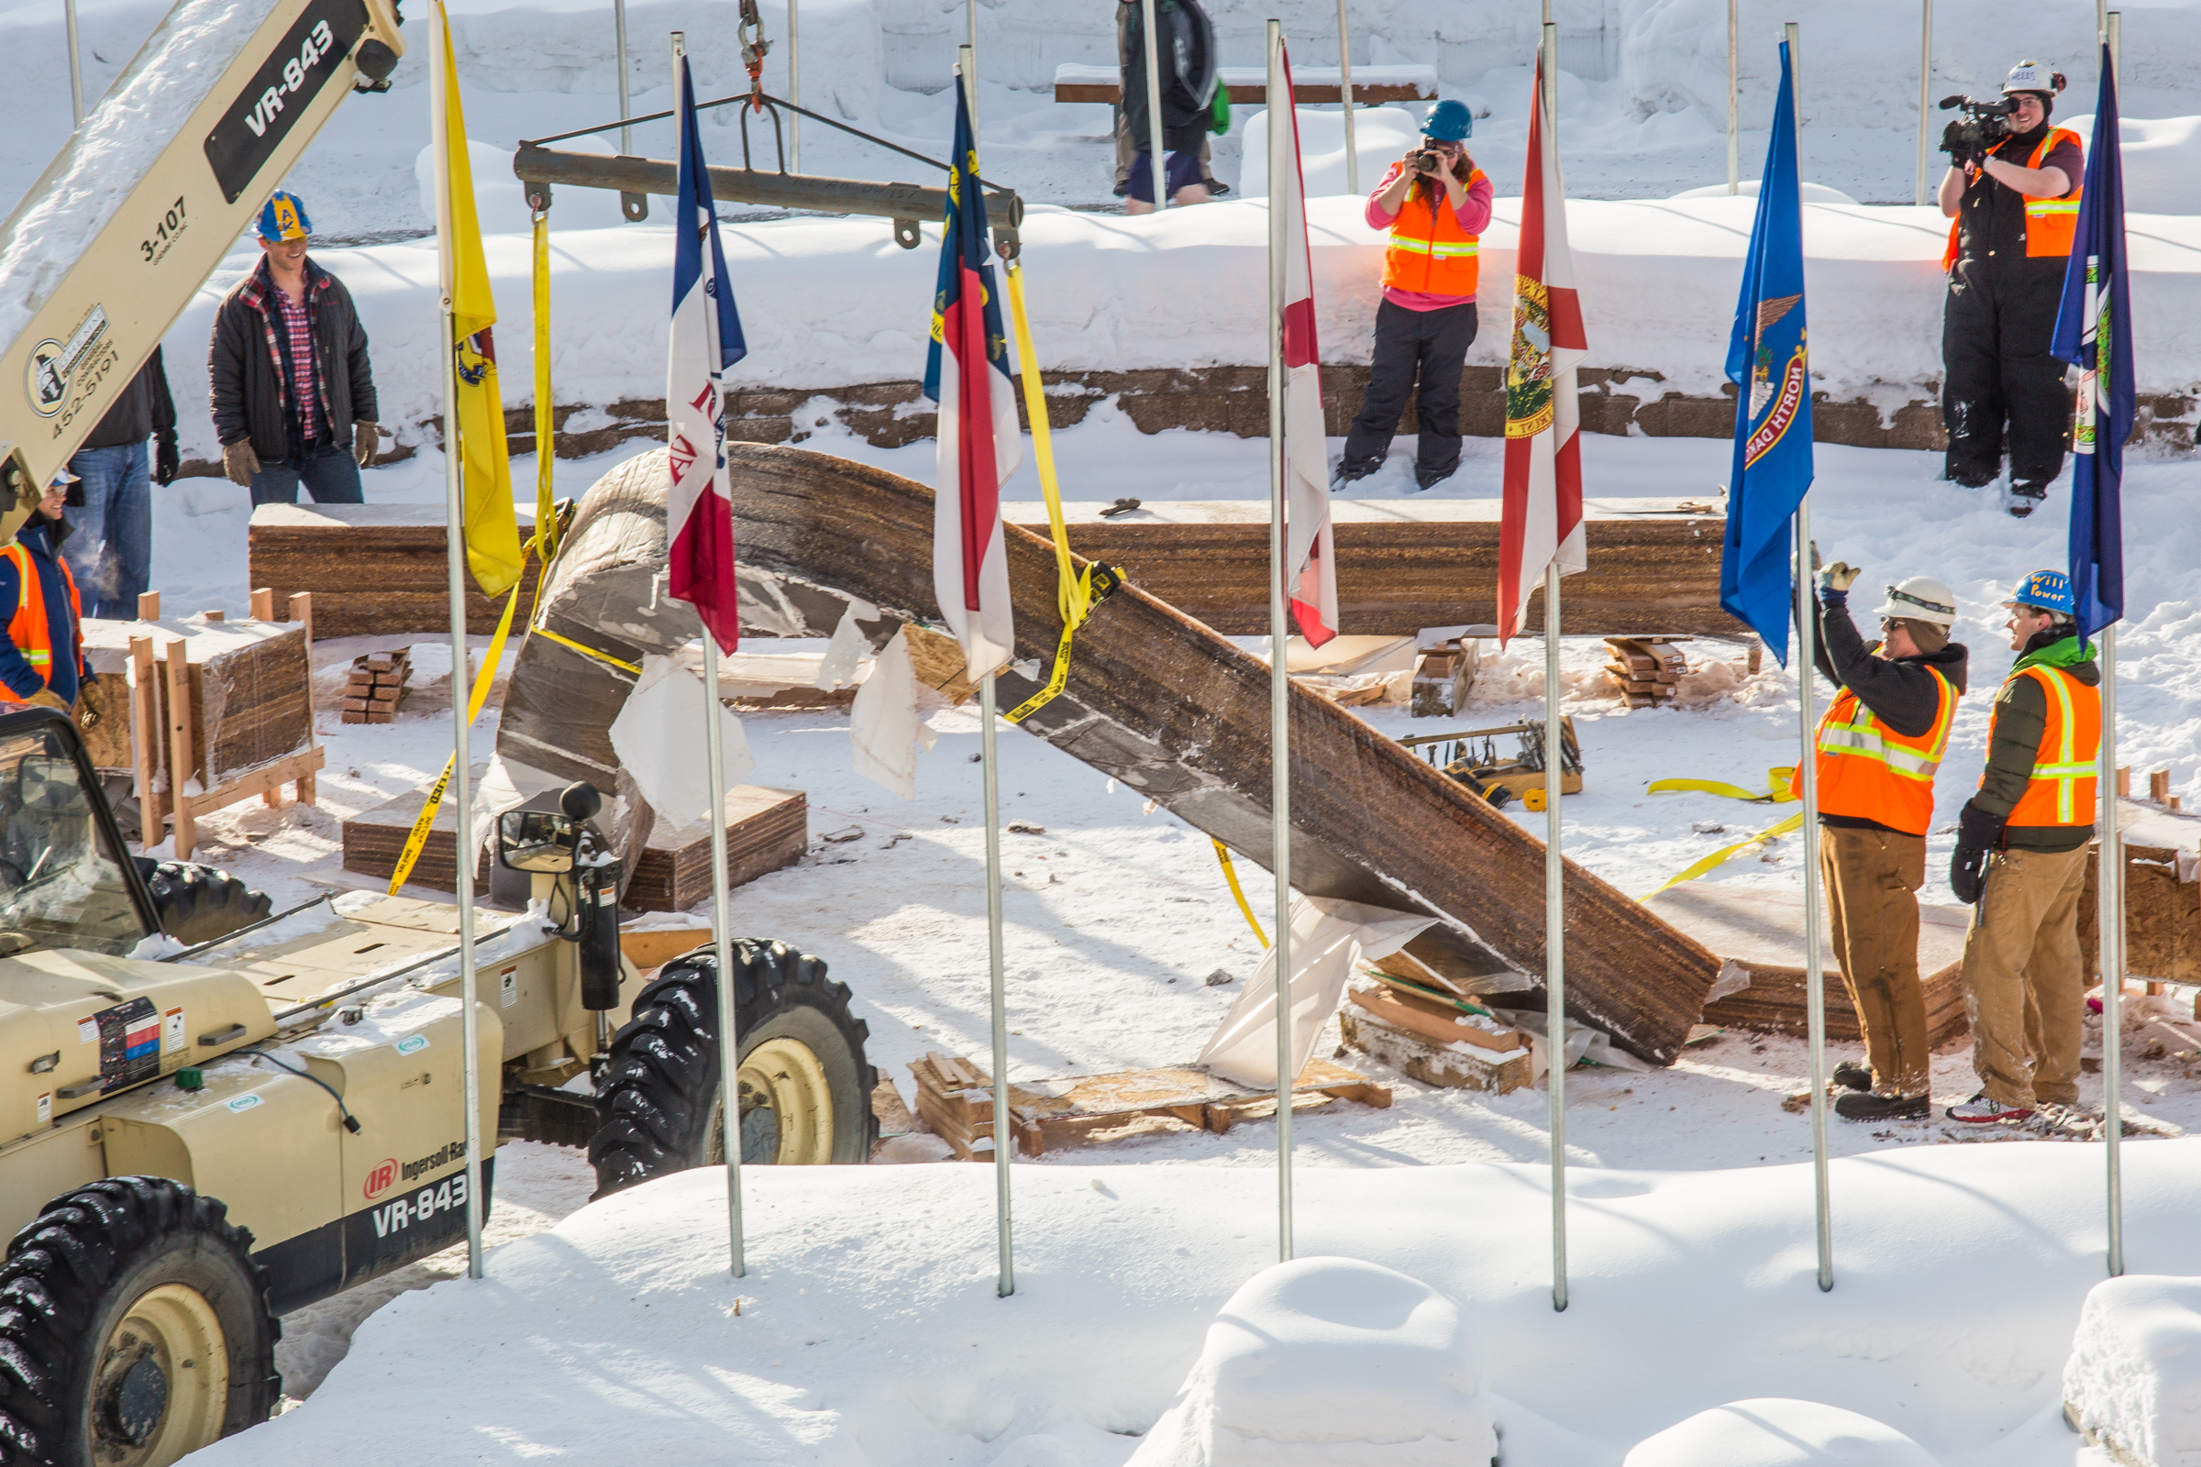
Engineering students and volunteers from GHEMM Company raise the 2013 ice arch
UAF Photo by Todd Paris

Slide 24
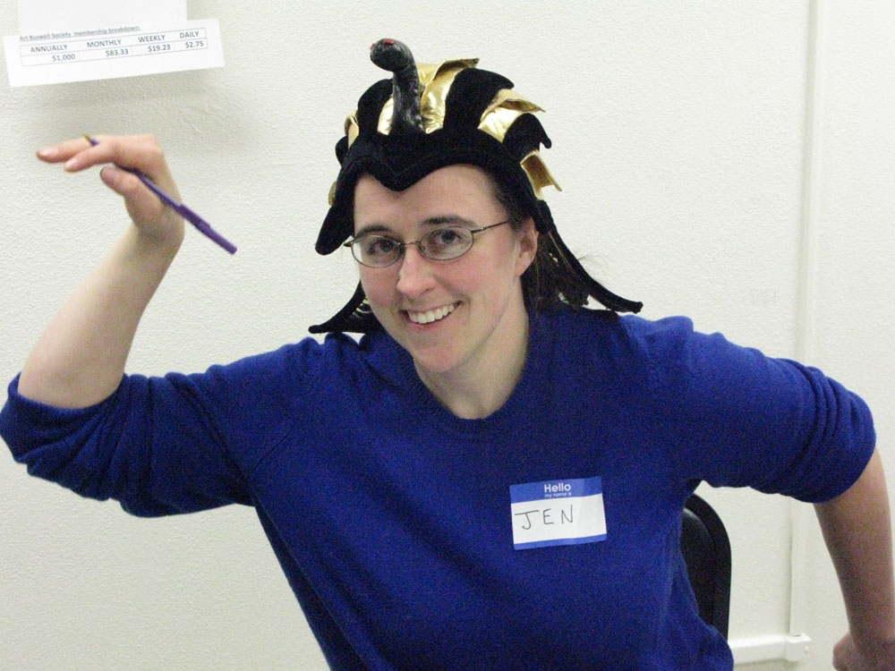
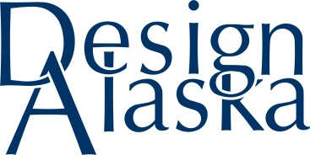

Slide 25
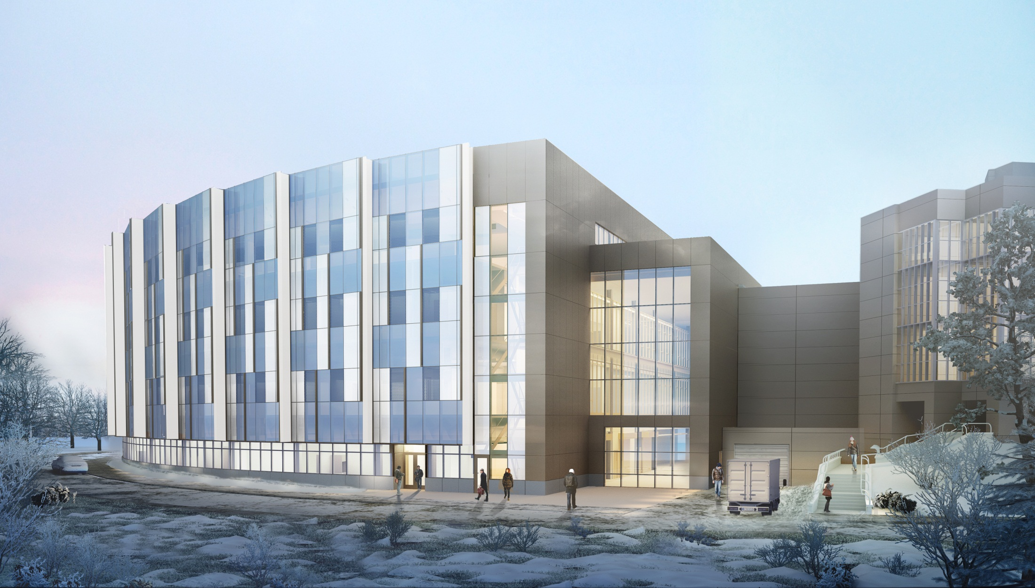
Duckering Building Extension - University of Alaska Fairbanks

Slide 26
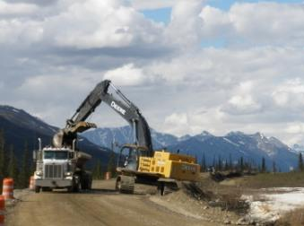
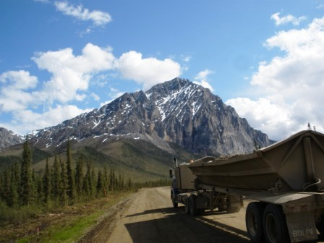
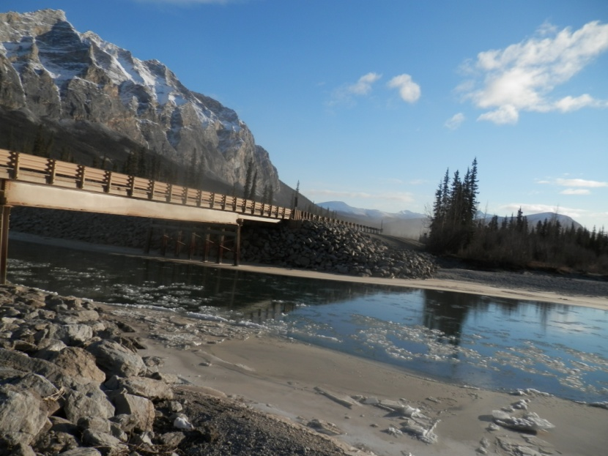
• Road Construction and Repair
• Highway Construction and Repair
• Erosion Control
Contractors

Slide 27
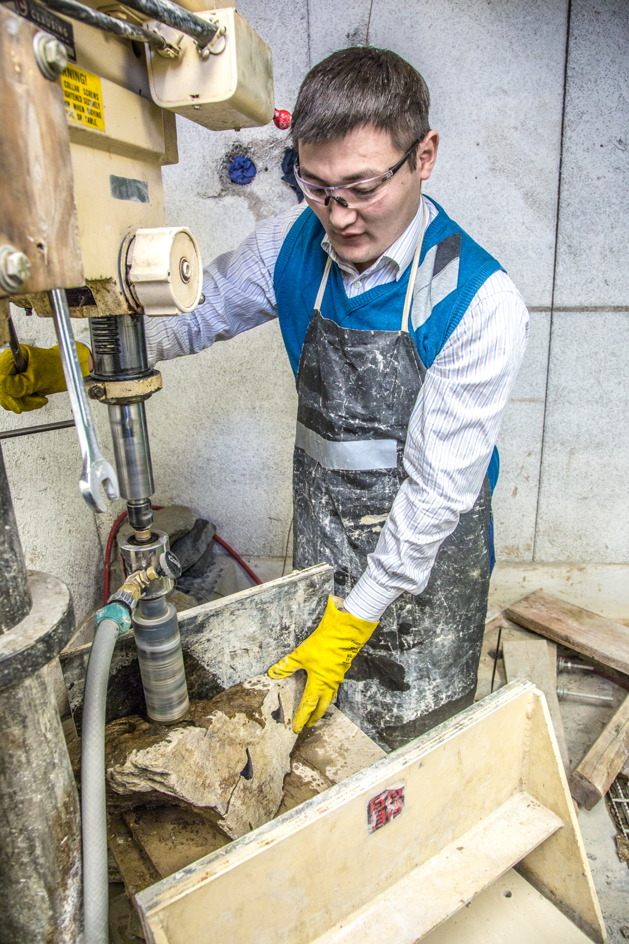
A UAF CEM graduate student works with samples of rare earth minerals
UAF Photo by Todd Paris

Slide 28
Math Counts Challenge!
Richard is thinking of three distinct, positive integers. He tells Barbara their sum is 9, and he tells Lori that their product is 24. What is the median of Richard’s three numbers?
Answer to follow

Slide 29
Answer: 3

Slide 30



THANK YOU TO OUR
GENEROUS SPONSORS
Contractors

Slide 31
2013 Tau Beta Pi Intiates
Photo courtesy CEM

Slide 32
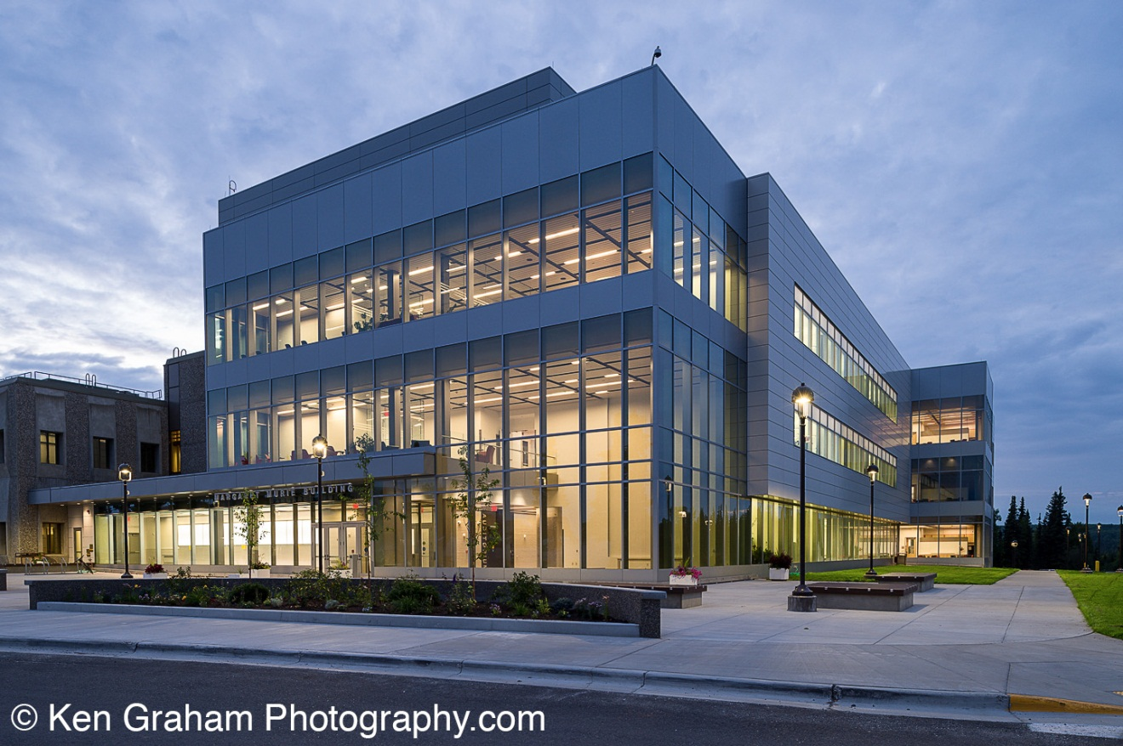
Margaret Murie Building - University of Alaska Fairbanks

Slide 33

Thank You To ConocoPhillips For Their Generous Sponsorship!

Slide 34
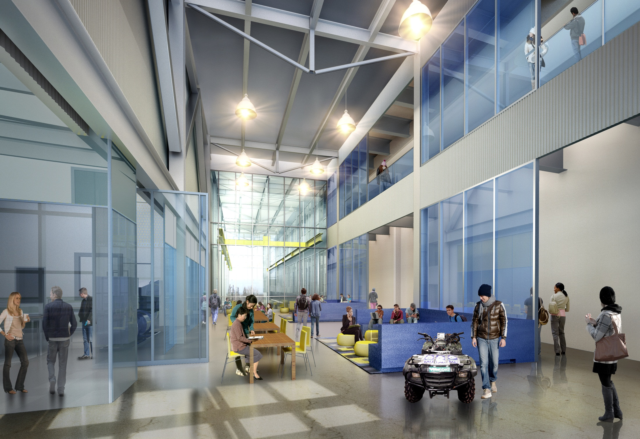
Duckering Building Extension - University of Alaska Fairbanks

Slide 35
Math Counts Challenge!
Molly has eight U.S. coins with a total value of 78 cents. She does not have any half-dollars. How many dimes does Molly have?
Answer to follow

Slide 36
Answer: 2 (dimes)

Slide 37
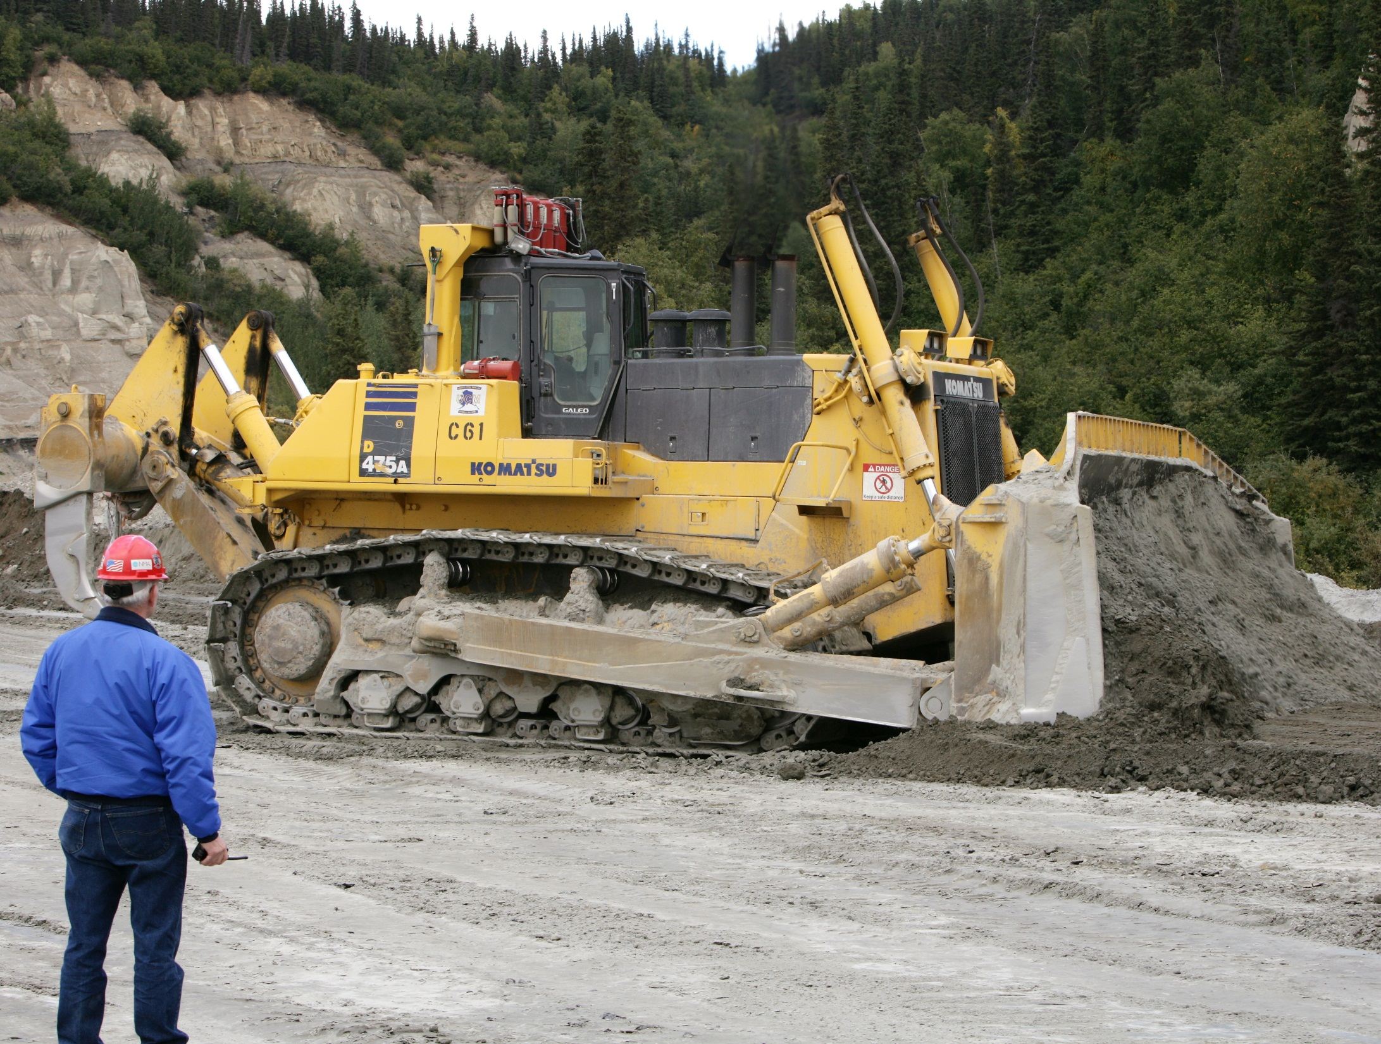

Slide 38
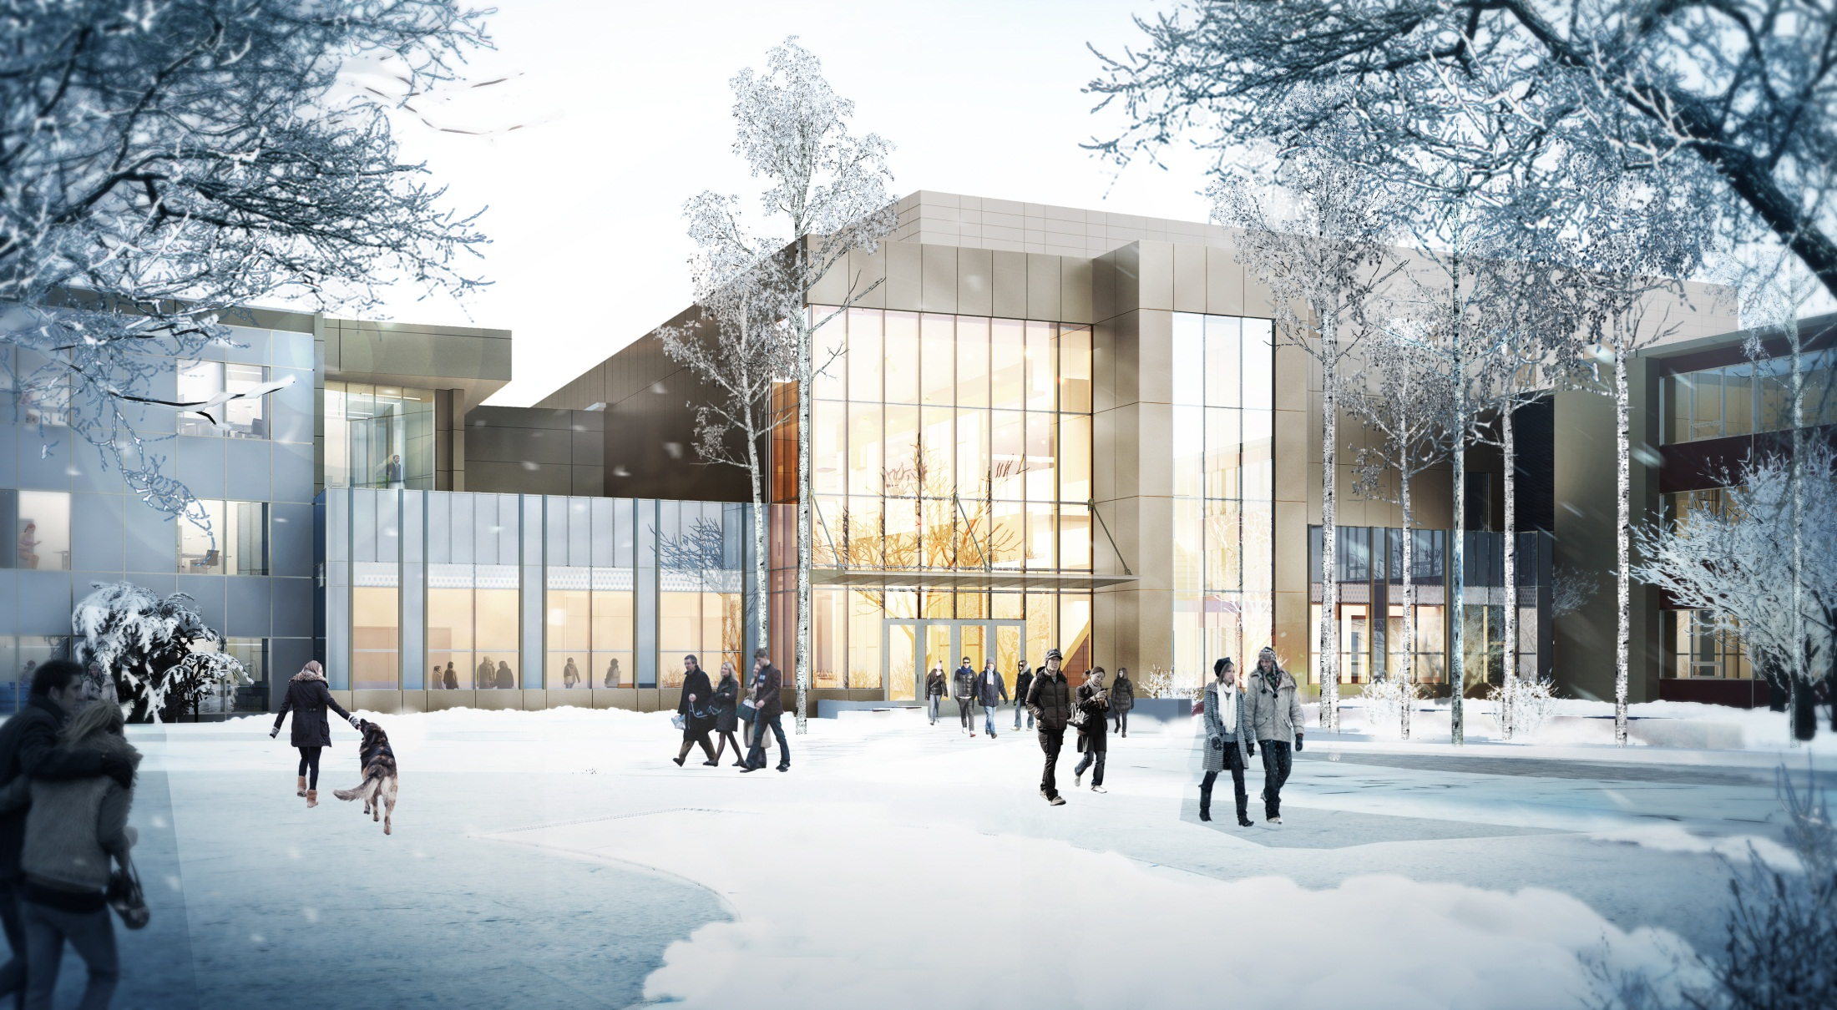
Duckering Building Extension - University of Alaska Fairbanks

Slide 39
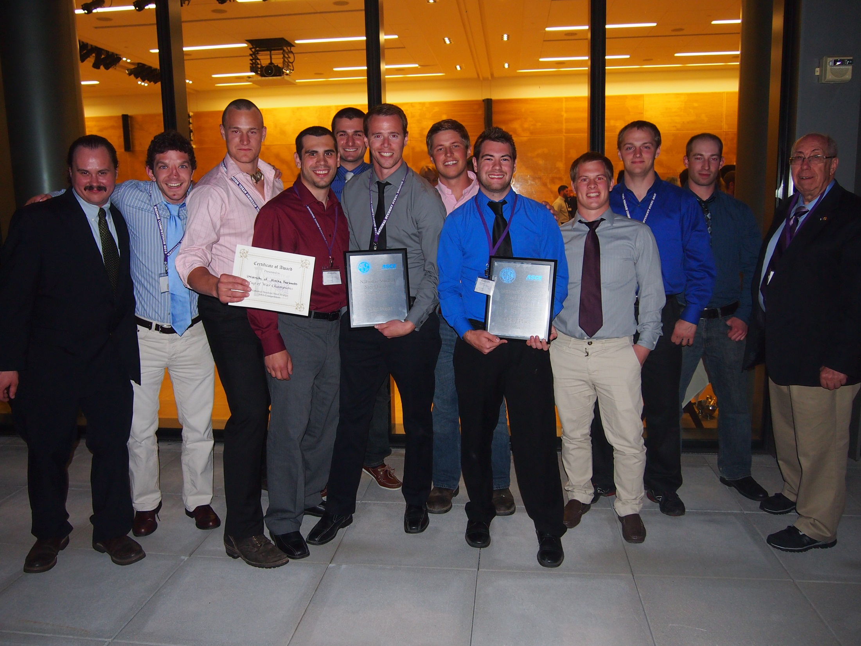
CEM students and faculty at the 2013 National Student Steel Bridge Competition

Slide 40
CONGRATULATIONS TO THE 2012 NEWLY REGISTERED P.E.s!
Ralph D. Nisenbaum, PE
Andrew M. Schultz, PE
John M. Kirkendall, PE
Shawna L. Sastamoinen, PE
Sheldon J. Helms, PE
Travis M. Eggleston, PE
Jason A. Walker, PE
Heather M. Gross, PE
Aaron H. Eversman, PE
Jason L. Millam, PE
Michael C. Dean, PE
Patrick W. Reinhard, PE
Richard F. Stalzer, PE
James J. Loftus, PE
CIVIL
CIVIL
CIVIL
CIVIL
ELECTRICAL
CIVIL
CIVIL
CIVIL
STRUCTURAL
STRUCTURAL
STRUCTURAL
STRUCTURAL
CIVIL
FIRE PROTECTION

Slide 41
Thank You To Our Sponsors!

Slide 42
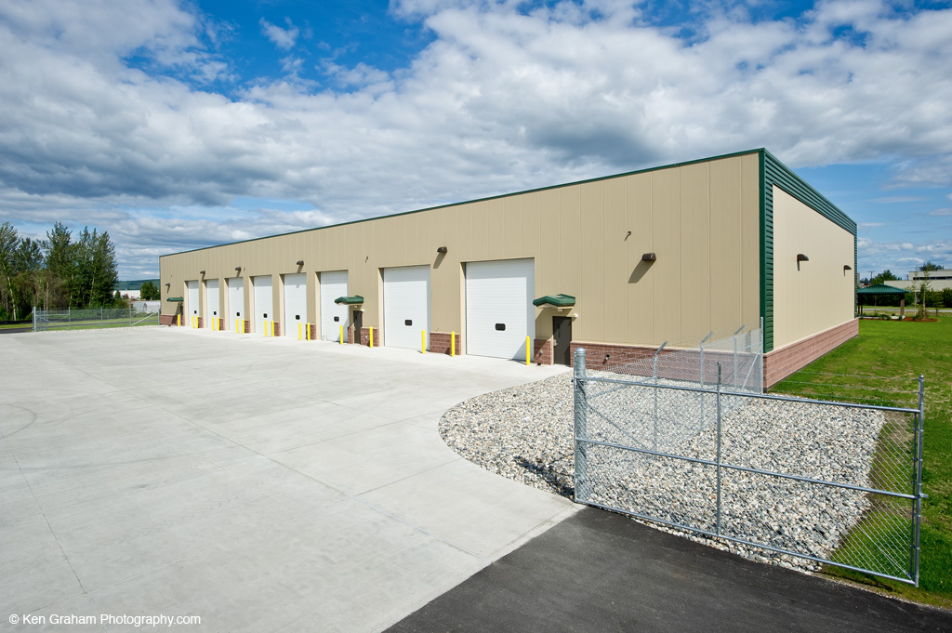

Slide 43
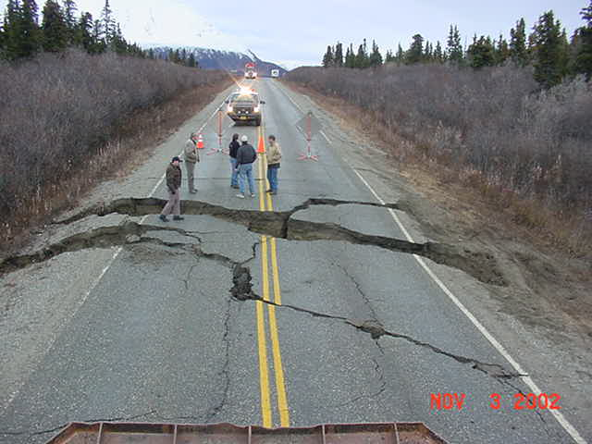


Slide 44
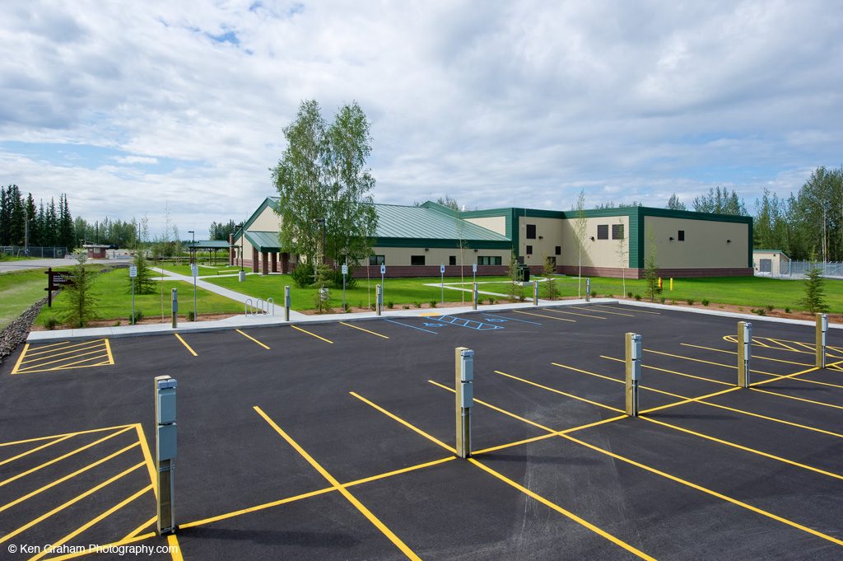

Slide 45
CONGRATULATIONS TO THE 2012 NEWLY REGISTERED P.E.s!
Chris H. Miller, PE
David A. Vanairsdale, PE
William T. Hrinko, PE
John D. Golden, PE
Isaac J. Rowland, PE
Timothy D. Henry, PE
Billy J. Brookins, PE
Donald L. Gillie, PE
Kelly S. Kehrer, PE
Rob J. Rader, PE
CONTROL SYSTEMS
FIRE PROTECTION
STRUCTURAL
STRUCTURAL
CIVIL
MINING & MINERALS
PROCESSING
CIVIL
STRUCTURAL
STRUCTURAL
CIVIL
CONTROL SYSTEMS

Slide 46


Slide 47
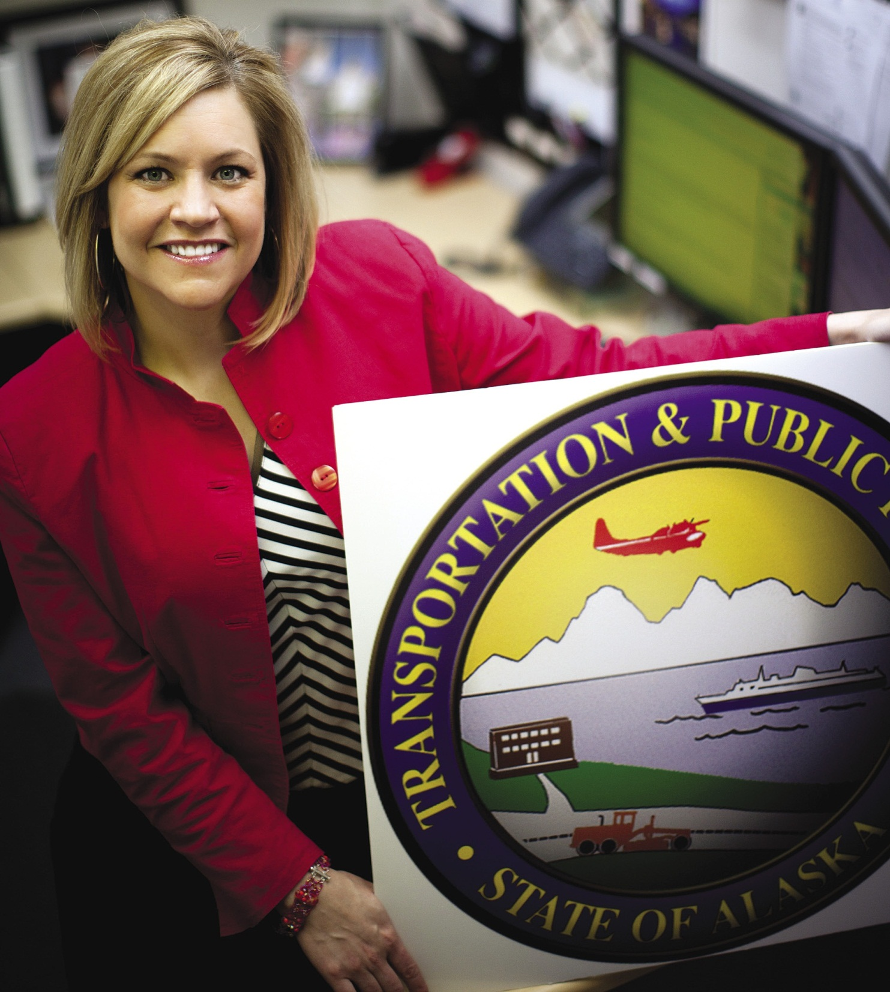

Slide 48
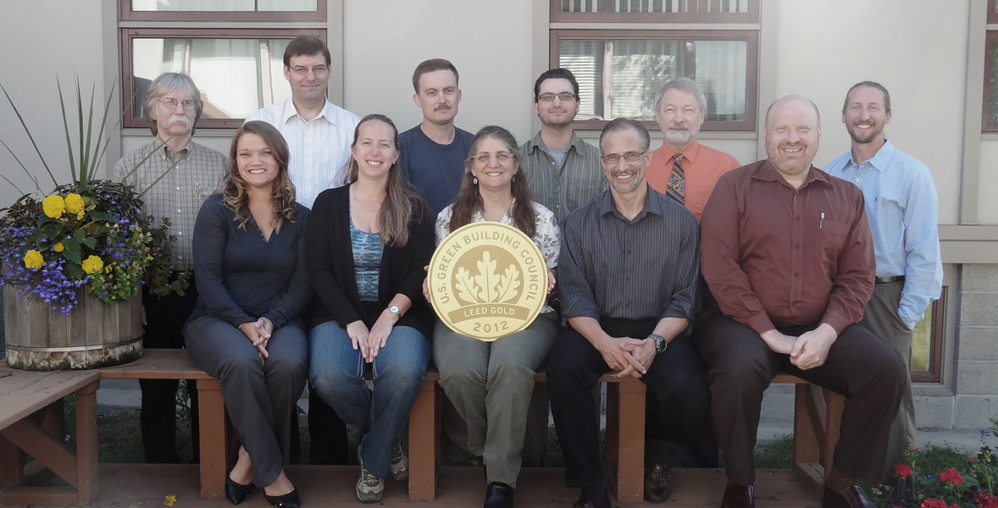

Slide 49
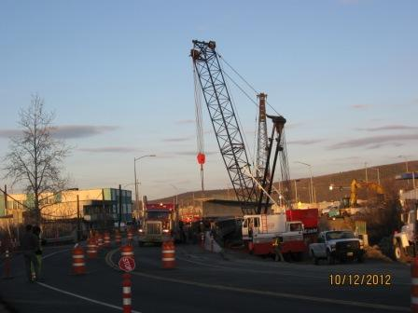
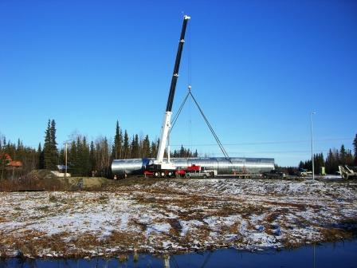
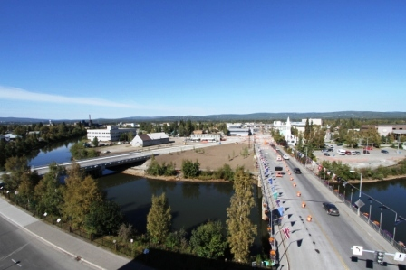
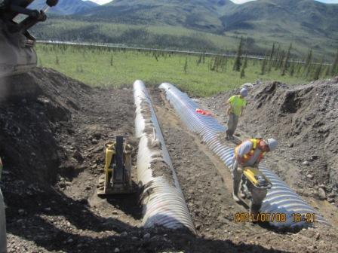
Contractors
• Bridge Foundation
• Utility installation
• Multiplate Installation

Slide 50
CONGRATULATIONS TO THE NEW 2012 F.E.s!
David Apperson
Jason Bell
Lyle Axelarris
John Burdick
Reuben Butteri
Taylor Duggar
Tachit Chairat
William Coleman
Timothy Henry
Alex Areneson
Patrizia Bolz
Robert Burdick
Tae Freeman
David Hooper
Russell Carroll
Nicholas Konefal
Patrick Brandon
Dustin Cozby

Slide 51
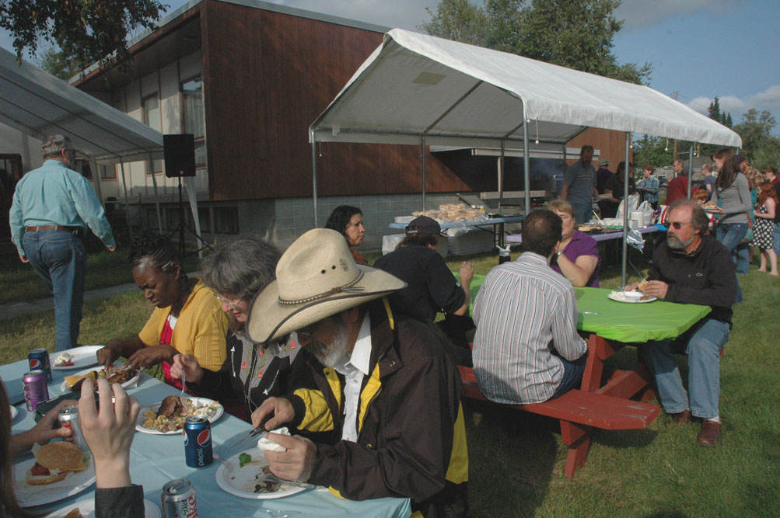

Slide 52


Slide 53
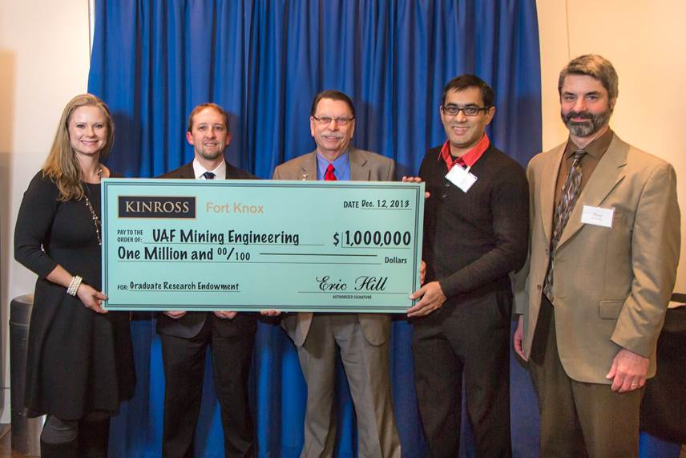
Kinross Fort Knox Supports UAF CEM Graduate Research
Photo Courtesy of CEM

Slide 54
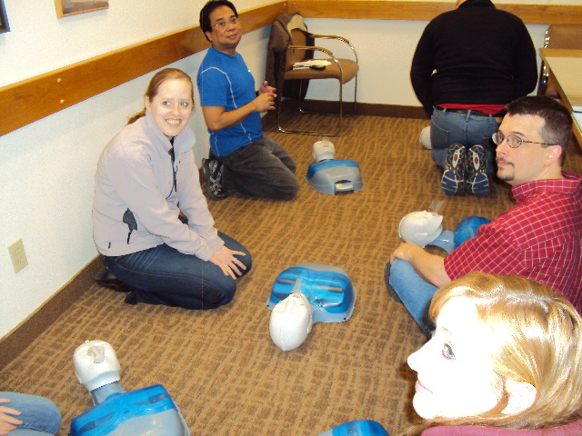

Slide 55
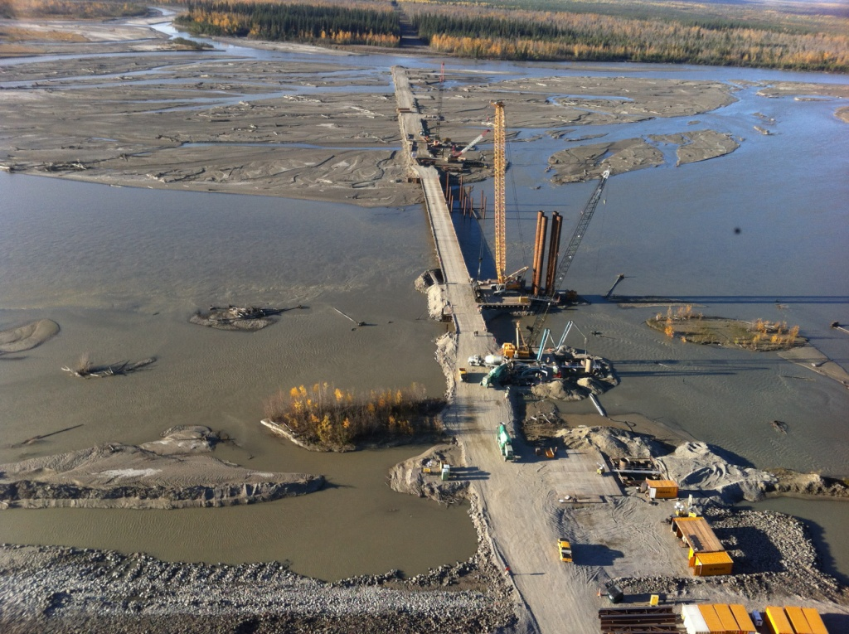

Slide 56
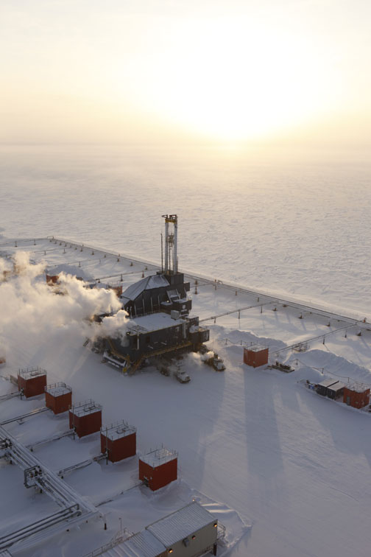

ConocoPhillips is pleased to support EWeek

Slide 57
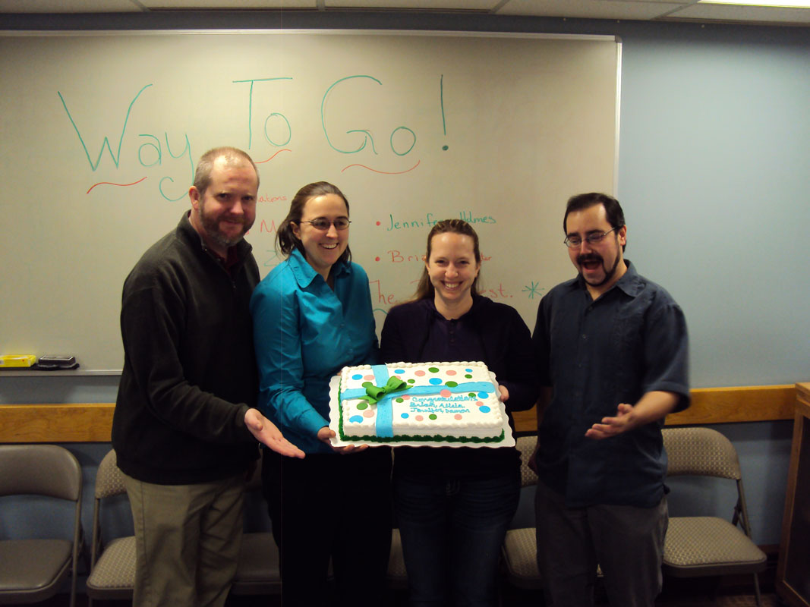

Slide 58
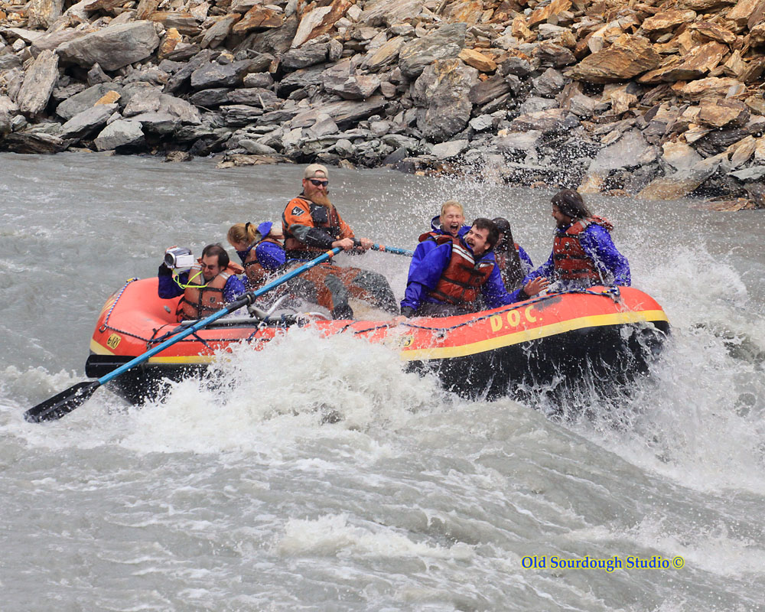

Slide 59
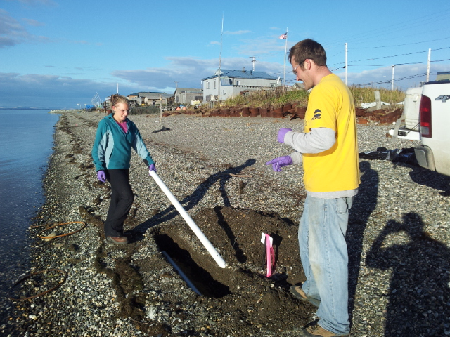

Slide 60
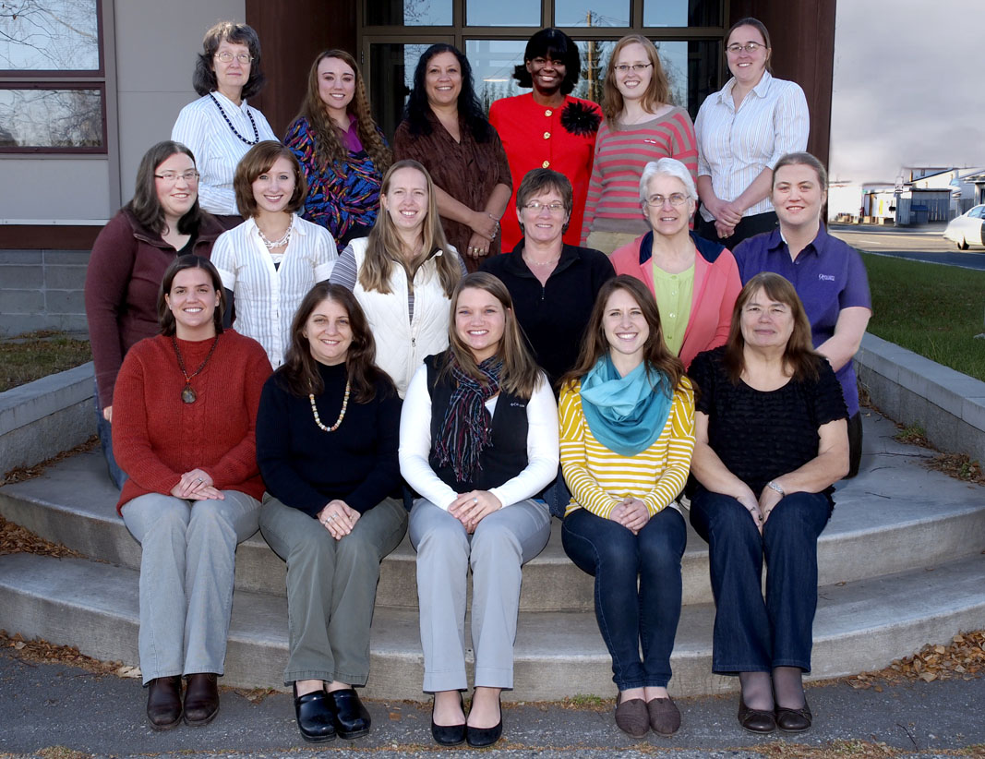

Slide 61
Math Counts Challenge!
Sharon drives 30 mi at 60 mi/h and 60 mi at 30 mi/h. What is Sharon’s average speed, in miles per hour, for the whole trip?
Answer to follow

Slide 62
Answer: 36 (mi/h)

Slide 63
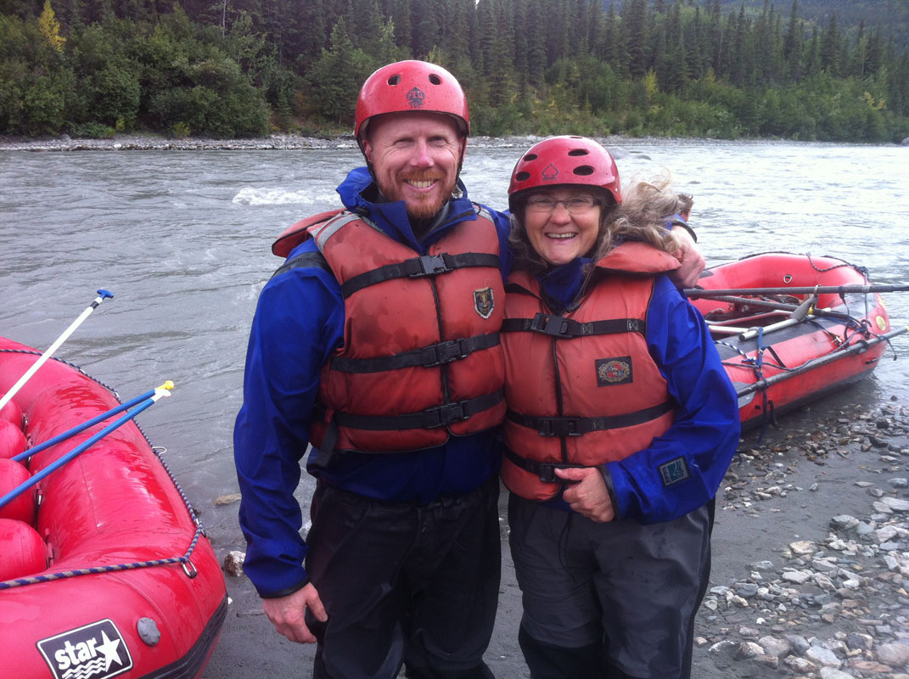

Slide 64
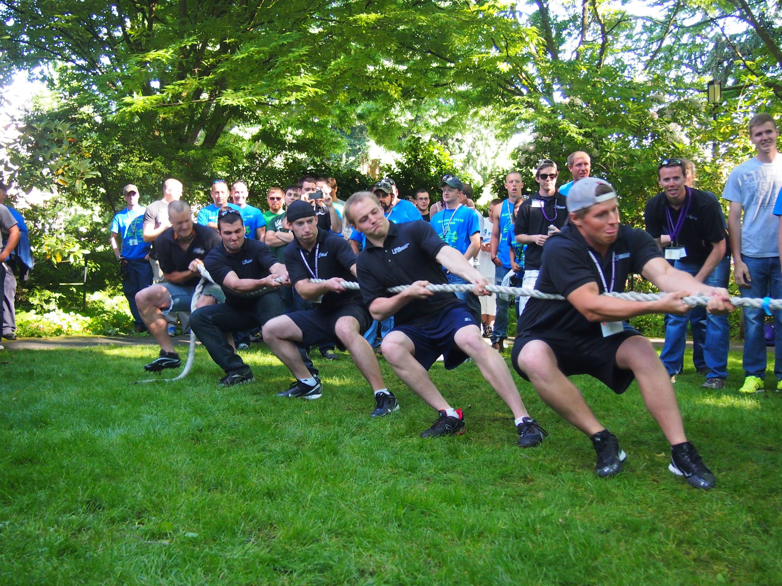
CEM students working together

Slide 65

Arctic Engineering
Geotechnical
Environmental
Natural Resources
Asset Management
Construction Observation and Testing
GIS
Hydrogeology
Instrumentation
Laboratory Testing
Mining Engineering
Seismic
Tunneling

Slide 66


Slide 67
Math Counts Challenge!
In the game Yahtzee®, five standard dice are tossed. What is the probability that all five dice show even numbers or all five show odd numbers? Express your answer as a common fraction.
Answer to follow

Slide 68
1
16
Answer:

Slide 69


Slide 70


Slide 71


Slide 72

Our Newest Sponsor
Dale Hahn, Group Leader, NVH/CAE Group, Arctic Cat, Inc.
UAF Snowmobile Team Captain(2000-2001)

Slide 73
Math Counts Challenge!
What is the value of 8 ÷ 8 − 8 + 8 × 8?
Answer to follow

Slide 74
Answer: 57

Slide 75


Slide 76



Slide 77


Slide 78


SB Electronics Capacitor:
“The Heart of the Motor Controller”
Power Ring Capacitor
Uses Film Technology
600V Rating
1000 uF (microfarad)
Capable of handling 500A ripple

Slide 79


Slide 80

12 Volt System and Headlights
12V system powers motor controller, BMS, dashboard displays, relays, and headlights
Stock headlights replaced with two 10W LEDs
Reduced draw on 12V system by 90%

Slide 81


Slide 82


Slide 83



Slide 84


